Slide 1
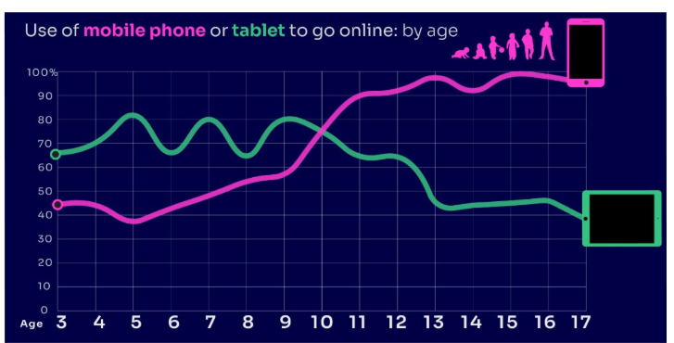


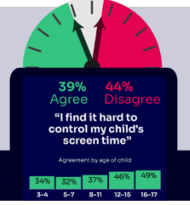


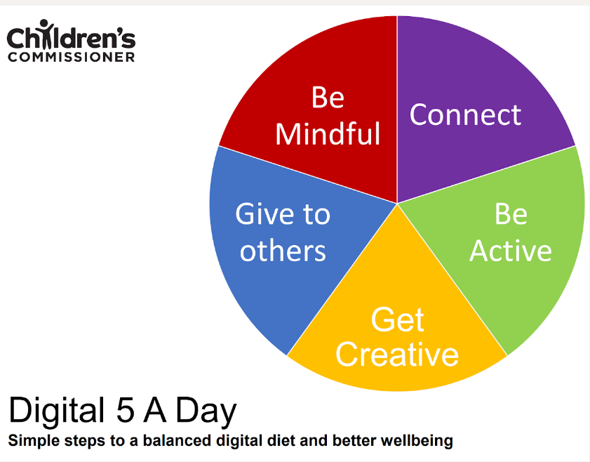

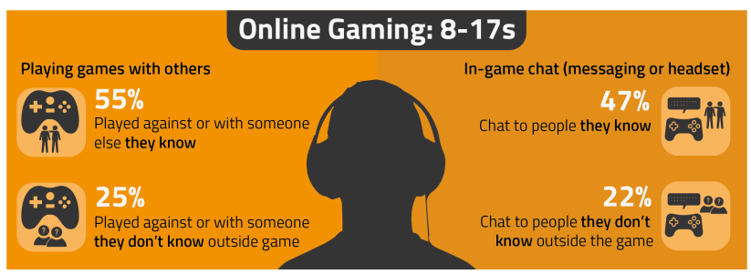

PARENT ONLINE SAFETY
NEW for 2025
A ready to use Presentation for Schools, Community Groups and Youth Centres
Notes:
This presentation brings together:
- the latest research and key findings on children’s and young people’s online use and risk
- parents’ views about their children’s media use, devices and supervision to monitor or limit use
- suggested resources and tips to empower parents to keep up with the latest trends/apps and games, manage controls and settings, and talk to children about risk - from bullying and sharing content, to extremism and gangs

Slide 2
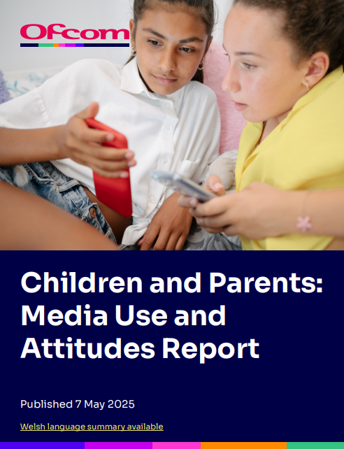
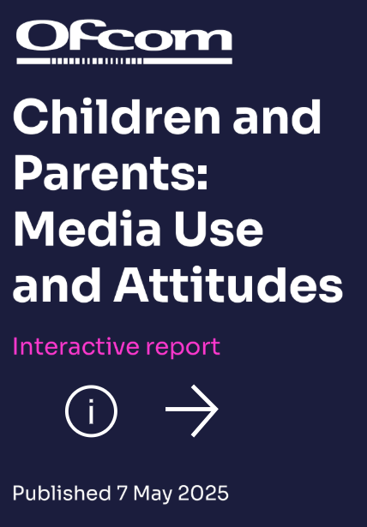

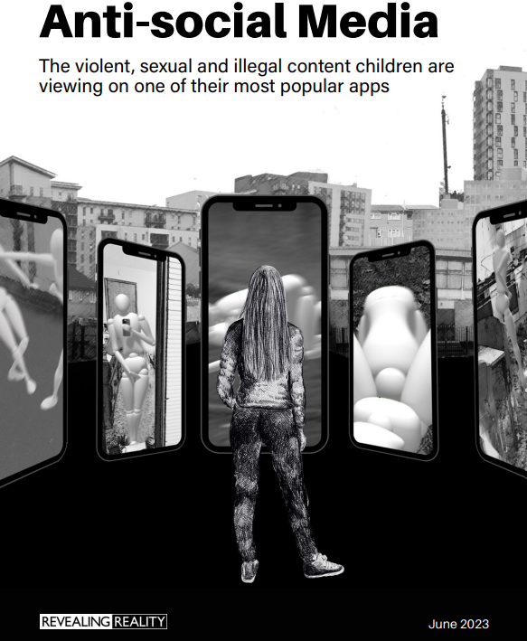


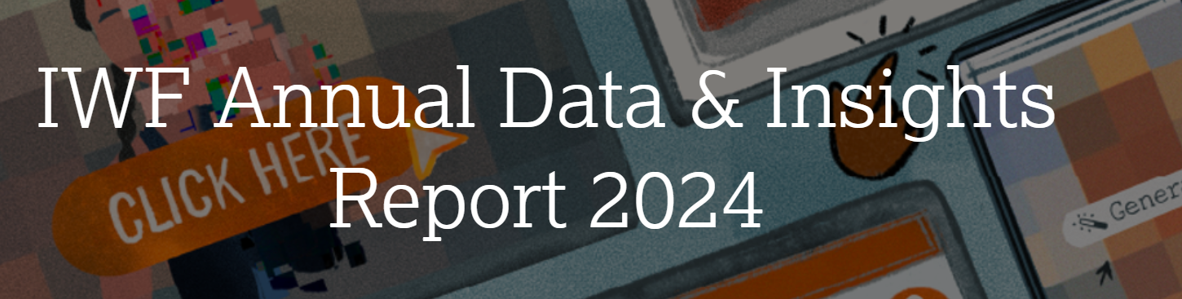
This presentation brings together:
Key Findings from:
  Children and parents: Media Use and Attitudes report
  Children’s Online User Ages 2025 Quantitative Research Study
  Children and parents: media use and attitudes report 2025 – interactive data
  IWF Annual Data & Insights Report 2024, published April 2025
  https://www.gambleaware.org/media/hbcp3qgd/exploring-the-lived-experience-and-views-of-gambling-among-children-and-young-people_final_0.pdf
  NSPCC (2024) Young people’s experiences of online sexual extortion or ‘sextortion’
  Internet Watch Foundation Annual Report 2023
  Evidence on pornography’s influence on harmful sexual behaviour among children Report 2023
  Revealing-Reality Anti-social Media Report 2023
Suggested Resources and Tips for Staff to help Parents/Carers:
  keep up with the latest trends, apps and games
  manage controls and settings
  talk to children about risk

Slide 3
Practitioner Guidance:
When it comes to online safeguarding, we recommend:
a drip-feed approach and incorporating online safety into other events where parents are present, rather than a single standalone session e.g. coffee mornings, parent evenings & celebration days
encouraging your pupils to present with you – why not tap into their knowledge of the latest trends, ask them to share their experiences or demonstrate how to set privacy settings and controls on devices
Before you begin:
We would not expect you to cover ALL of these slides in a single session - decide which topics to cover.
Feel free to amend the presentation – add/remove slides at your discretion to make sessions relevant.
You may wish to use a trigger warning depending on the topics you cover – see next slide.
Ensure you are familiar and confident with the content.
Refer to the practitioner notes in the notes section of each slide to support discussions.
Use these Questions Prompts on the slides to promote interaction.

Slide 4

Warning!
Notes:
Some of the content from this presentation may be sensitive or upsetting for parents/carers. You may wish to use/adapt this slide as a trigger warning, depending on the topic(s) you cover, e.g. online sexual abuse.

Slide 5
Planning your Parent Session:
Select REQUIRED SLIDES FROM EACH SECTION below to build and personalise your programme:
1. CHOOSE TOPIC(S):
Talking to Your Child (6-12)
2. ADD RELEVANT RISK FACTORS TIPS:
Risks and Negative Experiences(58-77)
3. PICK RESOURCES
Resources and Support (96-103)
Device Use & Ownership (13-18)
Supervision & Parental Controls (19-30)
Screentime (31-35)
Social Media & Gaming (36-50)
Age Requirements (51-57)
Staying Safe Online and Reporting (78-83)
Critical Thinking (84-95)
You may also wish to scroll through parentsafe.lgfl.net and showcase some of the resources here.

Slide 6


TALKING TO YOUR CHILD ABOUT LIFE ONLINE

Slide 7

What are you most WORRIED about when your child is ONLINE?
Notes:
ASK: Find out what parents are currently worried about
TELL: Despite the positive finding that over seven in ten (72%) 8-17-year-olds who use messaging/social media sites or apps feel safe when using these apps/online sites, either all or most of the time, the online space is a risky environment for children.

Slide 8
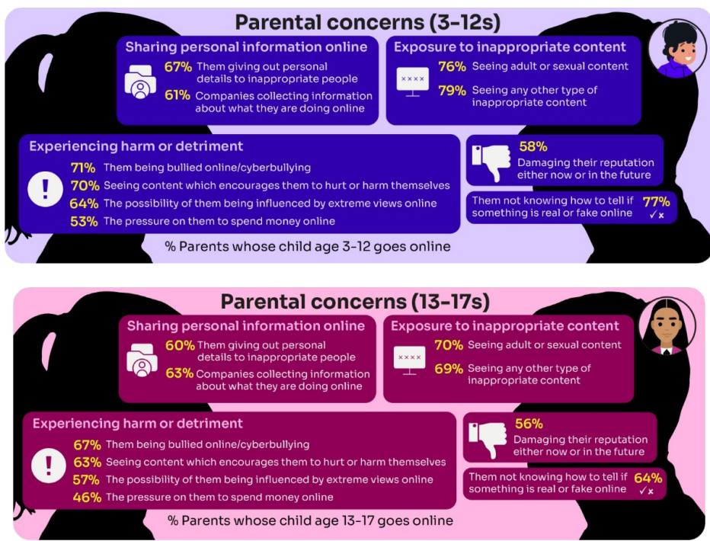
Summary of parental concerns (3 – 17 yr-olds)
Source: Children and parents: media use and attitudes report 2025
Notes:
Many parents indicate that they have concerns around various aspects of their children’s online activities.
The primary worry of all parents of online 3-17s continues to be potential exposure to age inappropriate content - three-quarters of parents said they were either fairly or very concerned about their child seeing content which is not appropriate for their age (76%) and the same proportion were concerned about them seeing ‘adult’ or sexual content (74%).
72% were concerned their child not knowing how to tell if something is real or fake online.
Seven in ten (69%) parents fear their child might be bullied online,
A similar proportion (68%) are worried about them seeing content that encourages them to hurt themselves.
61% of parents are concerned about their child being influenced by extreme views,
51% worry about the pressure to spend money online.
Unsurprisingly, there are many concerns which are more prominent among parents of younger (3- 12-year-old) children who go online.:
For example, a higher proportion of these parents compared to their counterparts (parents of teenagers) are concerned about their child being exposed to age inappropriate content (79% vs 69%), their child not being able to tell what is real or fake online (77% vs 64%), their child seeing content which encourages them to harm themselves (70% vs 63%), the 36 child giving out personal details to inappropriate people (67% vs 60%) and the possibility of their child being influenced by extreme views online (64% vs 57%).

Slide 9
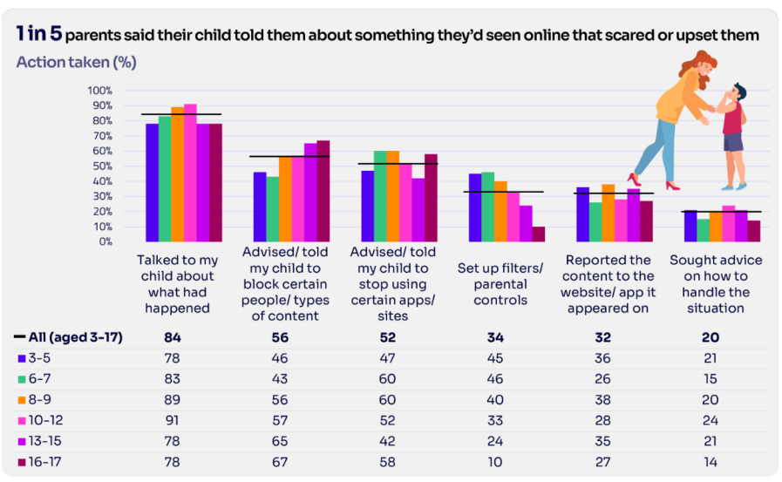
Are you CONFIDENT to TALK TO YOUR CHILD?
Is your child confident to TALK TO YOU?
WHAT WOULD YOU DO?
Are there any areas you would not feel confident or comfortable to discuss?
Younger children are more likely to tell a parent if they see something worrying or nasty online:
  92% of 8-12-year-olds say that they would tell a parent
  85% of 13-17s say that they would tell a parent
Source: Children and parents: media use and attitudes report 2025
Notes:
Almost all the parents in this group (99%) took some type of action in response to being told that their child had seen something that scared or upset them:
Over four in five parents in five (84%) had spoken to their child about what had happened.
Over half said they had advised their child to block a specific type of content or person (56%) and/or recommended that their child stop using certain apps or sites (52%).
Notably, there has been an increase this year in parents setting up filters or parental controls after an incident of this nature, up from 23% last year to 34% this year
However only about a third (32%) of parents had reported the content to the site or app on which it appeared
TELL:
You do not need to be an IT expert to help your child stay safe online. One of the best things you can do to protect your children is to talk regularly with them about their use of technology- just as you do with all other areas of parenting.
Having an open and honest approach is best - reacting, without involving them or talking to them, can often push behaviour underground, so it still happens, but you are less likely to know about it. This can increase risk to your child.

Slide 10
YOU don’t need to be an EXPERT … be a PARENT
It’s your choice – don’t let others dictate when the right time is to use tech.
Stay involved – make time to communicate, talk about what they are doing. What do they enjoy? What makes them laugh?
Don’t quiz them – have regular conversations. What's their favourite app? What is the best site to learn new things from?
Join in – watch them play a game and join in. Who are they playing with? Do they know the other players?
‘Show me how…’ – ask their advice to help you with your privacy settings, who you should add as a friend, are there any risks?
Lead by example – children learn as much from watching as they do from being told not to do something, so model good behaviour
Reassure them – tell them that they won't get in trouble and that you are always there to help
Notes:
ASK – What do you do that works well? Share good practice
REMIND - You do not need to be a tech expert to help your child with staying safe online. It’s ultimately about communication and being proactive.

Slide 11
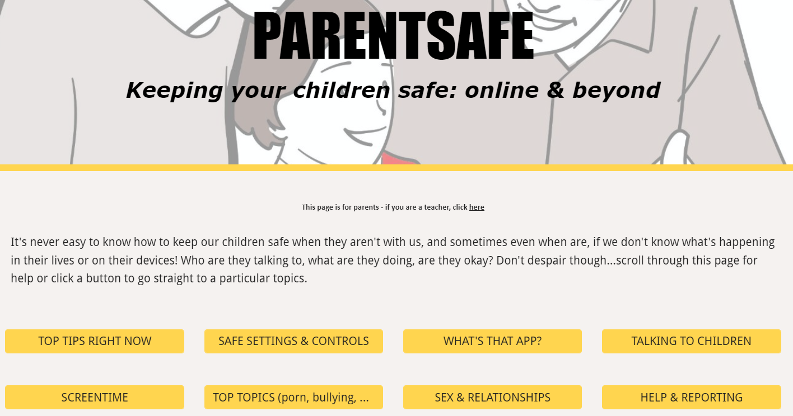
parentsafe.lgfl.net
Notes:
TELL - It's never easy to know how to keep our children safe, especially if we don't know what's happening in their lives or on their devices! Who are they talking to, what are they doing, are they okay? Don't despair though... We’ve created a dedicated website for parents and carers - simply scroll through ParentSafe for help or click a button to go straight to a particular topics. We will look at some of these resources and tips shortly

Slide 12
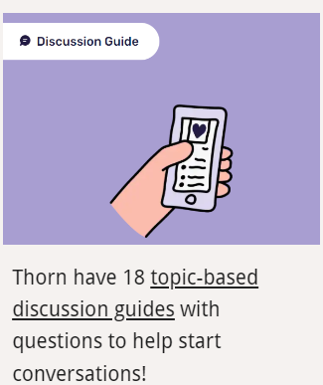

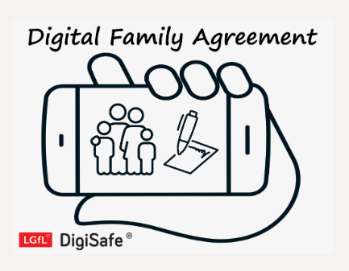

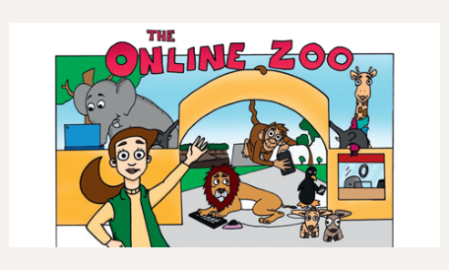
Find conversation starters, story time ideas and top tips to reinforce key safety messages at parentsafe.lgfl.net
Notes:
Feel free to point out some of these free resources for parents to reinforce safety messages and start those key online safety conversations:
TELL:
For younger children, it’s important to talk about boundaries, being kind to others and what they can do if they see or experience anything that worries or upsets them. Story time books e.g. ‘The Online Zoo’ and ‘#Goldilocks – a Fairytale for the Digital Age’ are great ways to discuss risk, consequences and positive strategies in a non-judgemental, age-appropriate way.
For older children, Thorn have 18 topic-based discussion guides with questions to help start conversations!

Slide 13
DEVICE USE AND OWNERSHIP

Slide 14
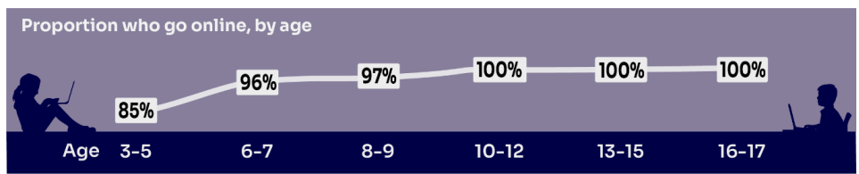
HOW MUCH DO YOU KNOW about your child’s life online?
Almost all children (96%) aged 3 – 17 went online in 2024, highlighting the centrality of the internet in their lives:
    Younger children commonly use tablets to go online
    Older children are more likely to use mobile phones
Source: Children and parents: media use and attitudes report 2025
Notes:
TELL:
We will be looking at 3–17-year-olds patterns of media use, how they access different sources of media online, and the types of online activities they are participating in. This includes their behaviours and habits in terms of viewing, playing, learning, and interacting
Almost all children from aged 5yrs (96%) went online in 2023, highlighting the centrality of the internet in children’s lives.
And we mustn’t forget that being online does create a lot of opportunity and joy for most of us. So, let’s think about how we can minimise risk and reduce their exposure to harm.

Slide 15
Does your child have their OWN MOBILE PHONE? If so, is it a SMART PHONE?
What AGE do you think is appropriate?
Source: Children and parents: media use and attitudes report 2025
Notes:
By the age of 11 nine in ten (91%) children aged 3-17 own their own mobile phone. in the period before they progress to secondary school, children become more likely to use a mobile phone to go online, while younger children (those aged 10 and under) are more likely to use a tablet.
TELL - A common debate is about the age at which children should be able to use smartphones. These are mobile phones that can access the internet and have apps installed on them. Some parents have opted for non-smart’ phones, which are mobiles that usually only have text and call capabilities.

Slide 16

SMARTPHONE or ‘NON’-SMART / BRICK phone?
REMEMBER IT’S YOUR CHOICE
Every child and situation is unique,
and you are best placed to know their needs
Internet access
Social media, apps and games
Notifications
Anytime connection
Parental controls
NO internet access
Some games
Anytime phone calls and texts
Limited parental controls
Notes:
ASK THEM TO CONSIDER:
How will they reduce any risks?
What does their child need the mobile for? Is it simply to stay in touch with you - then a ‘non-smart’ phone might be enough. But if you want them to access homework or learning on their mobile, then a smartphone might be better.
How you can help them child learn the basic skills to use it safely e.g. to send a message, take part in a group chat, manage their timings etc. Children need our support with developing these skills. You wouldn’t give your child a knife without guidance and support, similarly a phone can cause harm and so need to think about this.
Whatever they decide, communication is key - involve the child in the process to establish shared expectations.
Remember to set up parental control settings or use a parental controls app to help them stay safe.

Slide 17
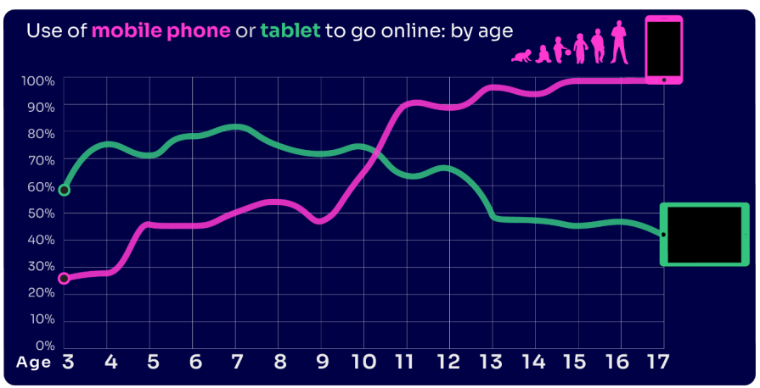
By age 11, nine in ten children own their own mobile phone, distinct from using a family device
This correlates with transition from primary to secondary school.
Source: Children and parents: media use and attitudes report 2025
Notes:
As in previous years, the point at which it becomes more likely that a child will go online using a mobile rather than a tablet closely correlates with the age at which mobile phone ownership among children becomes almost universal.

Slide 18
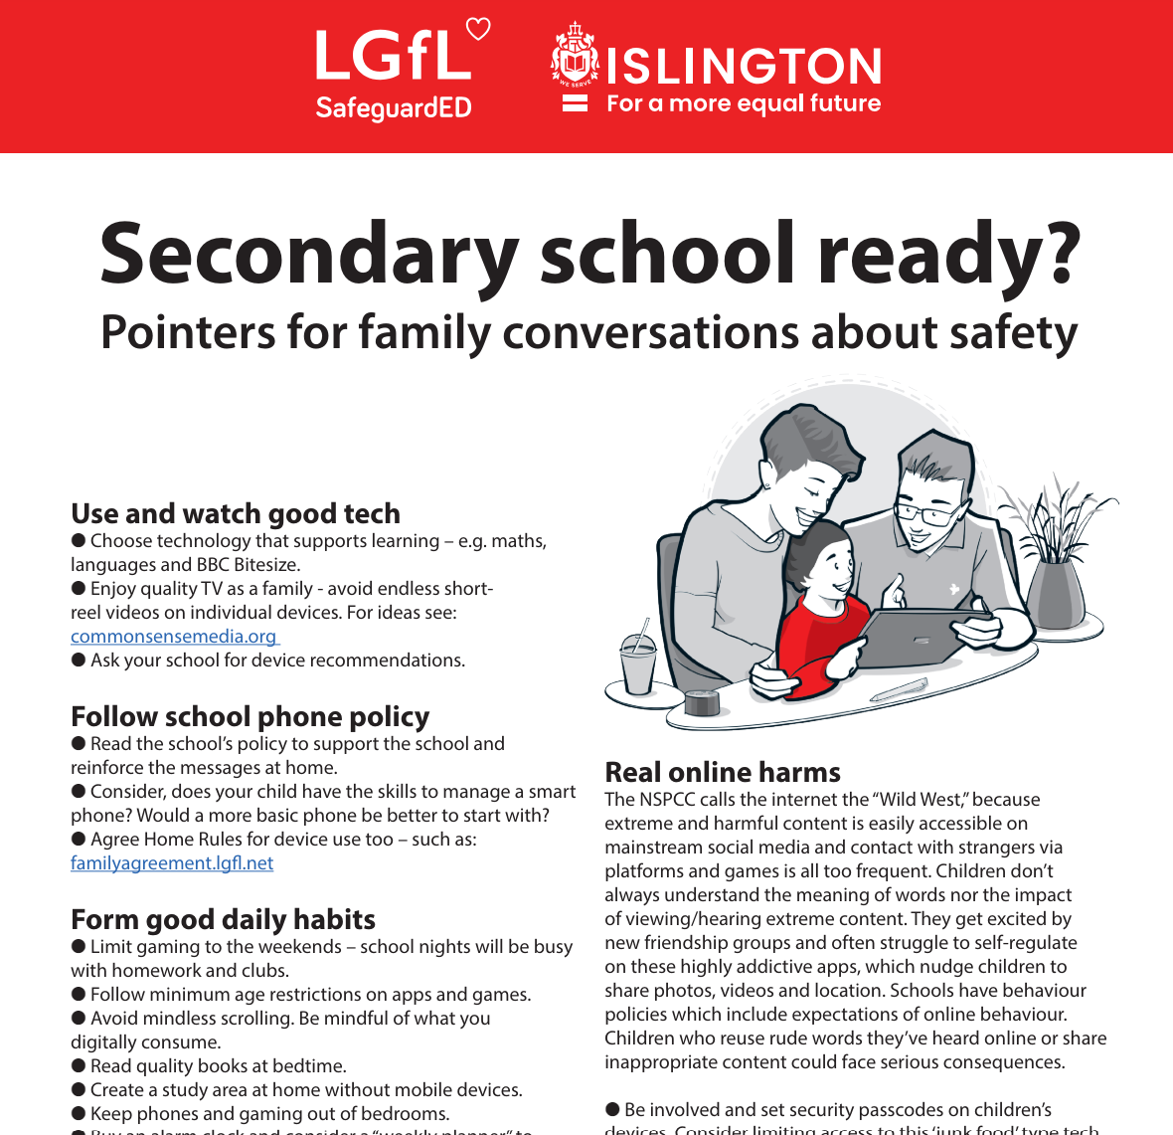
To help you with the transition of pupils from primary to secondary, why not download our FREE Leaflet for parents:
understanding risk
using tech for good
healthy habits and tips
when best to get a phone
Notes:
https://drive.google.com/uc?export=download&id=1-E_5IiDOfw3EQBPQgbGe9f2Qy3T7o_ny…
Take them through some of the key points from this leaflet on healthy habits and using tech for good

Slide 19
SUPERVISION AND PARENTAL CONTROLS

Slide 20
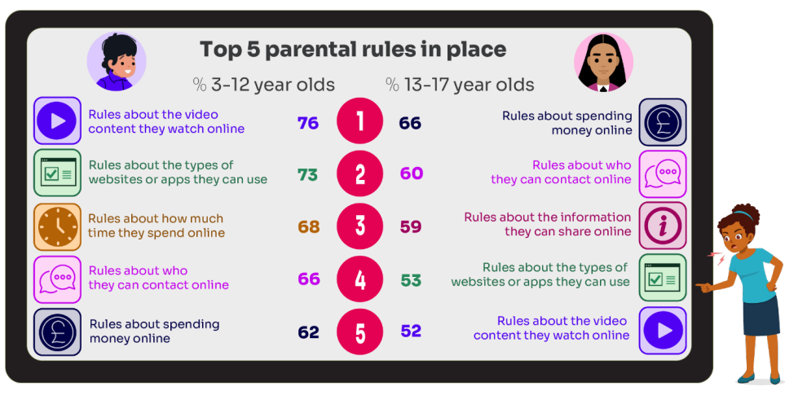
What RULES do YOU SET about being online?
What do you do that WORKS?
While parental concerns in some areas have increased considerably, their enforcement of rules appears to be diminishing, partly due to parents’ resignation about their ability to intervene in their children’s online lives.
Source: Children and parents: media use and attitudes report 2025
Notes:
ASK: What rules do you set for your children? How confident are you in implementing them?

Slide 21
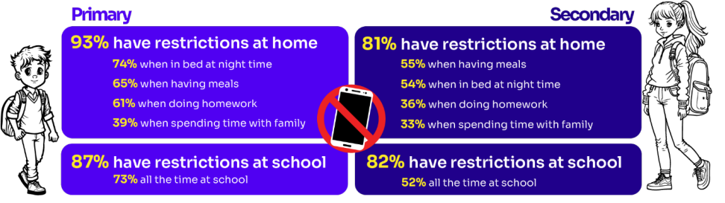
Do you RESTRICT their MOBILE PHONE USE?
If so, have you found it CHALLENGING?
Source: Children and parents: media use and attitudes report 2025
Notes:
ASK: What restrictions do you set for your children? How confident are you in implementing them?
More than eight in ten (83%) 8-17s in this group say there is at least one time when they cannot use their phones at home. Looking at specific restrictions when a child in this group is at home, nearly six in ten (58%) of 8-17s who go online via their phone say they are not allowed to use their phones when they are in bed at night, with a similar proportion (57%) reporting that they are not allowed to do so while having meals. Younger children in this group are more likely than older ones to report having each of these restrictions in place

Slide 22

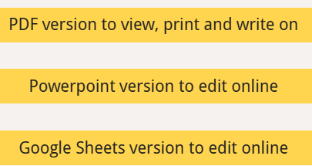
Why not have a family agreement to:
clarify what is allowed...or not
establish ground rules like no phones at the table or in the bedroom at night-time
agree shared expectations to reduce arguments and keep everyone safe & healthy
Download it at parentsafe.lgfl.net/digital-family-agreement
Notes:
TELL:
To help facilitate this, LGfL have created a free digital family agreement that parents could sit down and populate with all family members to agree what is and is not allowed within their family around tech use. This includes parents! WE as parents also need to role model good behaviour.

Slide 23
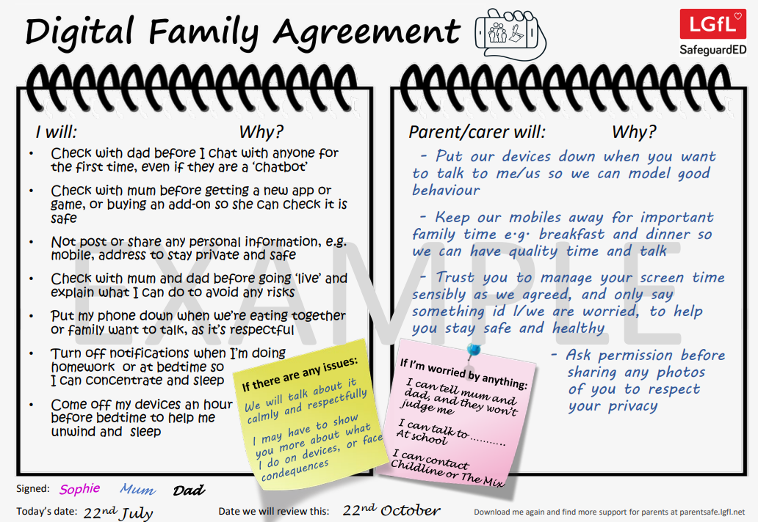
SHARENTING!
parentsafe.lgfl.net
Notes:
TELL - This is an example of a completed agreement – you may wish to take them through the sample statements to help them get started.
ASK – Have they heard of the term ‘Sharenting’?

Slide 24

What’s wrong with SHARENTING?
(when parents share photos of their children online)
Identity theft
Permanence of digital content
Losing control of images
Exposure to child predators
Creates their children’s digital footprints before they are old enough to consent to it
Notes:
TELL:
Sharenting is when parents share photos of their children online. Usually, images are shared on social media platforms to capture memorable moments in children’s lives, such as first steps, trips to the zoo, school performances, and holidays.
more than 75% of parents have shared their children’s images on social media, and 33% have never asked their children for permission before sharing photos online.
EXPLAIN THE RISKS:
Identity theft - sharenting habits expose incredible amounts of personal information about their children. More than 80% of parents use their kids’ real names on social media posts.
Permanence of digital content – even if a post is deleted, someone could have taken a copy, which could put the child at risk or lead to bullying or teasing in the future
Losing control of images - most social media sites own any content posted to their platforms. This clause is usually hidden in the terms and conditions that most users scroll through without reading. This means the platform on which it is shared has ownership of the image.
Exposure to child predators - images parents share can contain information that allows predators to track children. E.g. school or uniform, street name of the family home, while geotags can allow people with nefarious intent to track the child’s real-time location. In addition, because parents cannot control how far these photos spread, it is impossible to know where they end up, even with privacy controls in place.
Since sharenting essentially creates their children’s digital footprints before they are old enough to consent to it, the practice can also create privacy issues between children and parents that can erode trust in that relationship. For all these reasons, it is important for parents to think twice before posting about their kids.

Slide 25
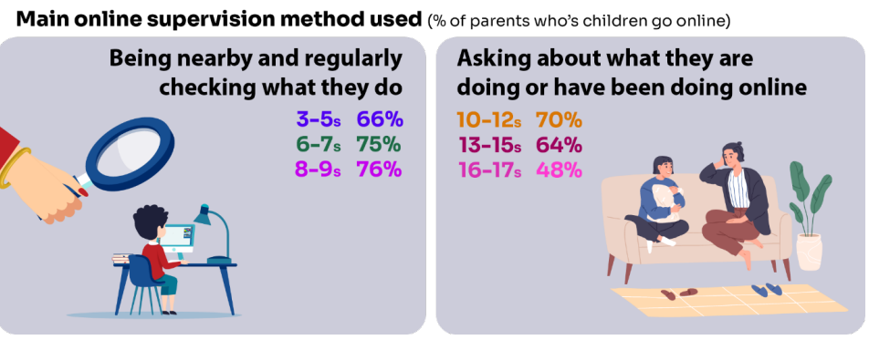
Do you SUPERVISE your child’s online activity? HOW?
Source: Children and parents: media use and attitudes report 2025
Notes:
TELL - The two most commonly-employed types of parental supervision among parents of 3-17s are to:
ask their child about what they are or have been doing online (59%), and
be nearby and regularly checking what their child does (55%).
Of course, this varies as the child gets older and more independent, as parents decreasingly monitor their child’s online life

Slide 26

Have you set up parental CONTROLS/PRIVACY SETTINGS for ALL DEVICES and NETWORKS?
Controls need to be set up on both the broadband connection AND each individual device
These do not come as standard so it’s worth checking
They are important because they allow you to:
  Block and filter upsetting or inappropriate content or sites
  Plan what time and how long your child can go online for
Notes:
TELL – it is important that these controls are set up on BOTH the broadband connection AND each individual device
About seven in ten (73%) parents of all 3-17-year-olds use at least one type of technical tool or control to manage their child’s access to online content; parents of 8-11-year-olds are more likely than those of older children to use at least one of these tools (84% vs 70% of parents of 12-15s and 54% of parents of 16-17s respectively). The most commonly-used technical tool used, across all parents of 3-17s, were parental controls built into the device by the manufacturer, e.g. Windows, Apple, Xbox, PlayStation etc. (32%). (Ofcom 2024)

Slide 27
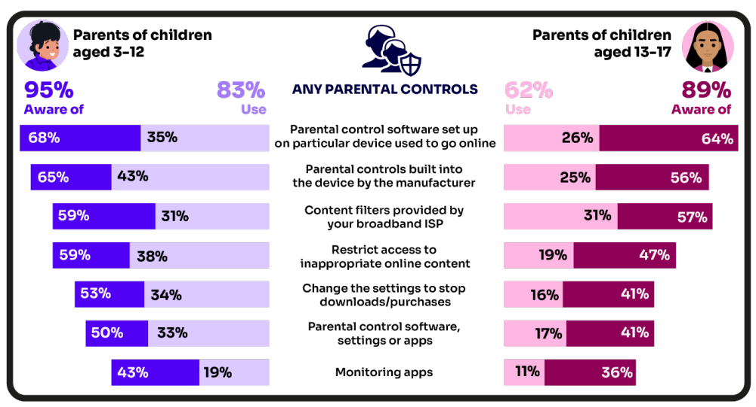
Are you AWARE of these PARENTAL CONTROL TOOLS?
Which ones have YOU USED?
‘I prefer to supervise my child’s online use by talking to them about setting rules’
(39%)
Source: Children and parents: media use and attitudes report 2025
Notes:
There is a high awareness of technical control tools among parents, BUT many are choosing not to use them
ASK – Why do you think this is the case?
TELL – it’s not as complicated or scary as you think. Let’s look at some top tips and resources to support you.
Parents of younger children are more likely than those with older children to use at least one type of technical tool or control to manage their child’s access to online content, with 83% of parents of 3-12s using at least one of these tools compared to 62% of parents of 13-17s.
Among all parents, the most frequently-used technical tool or control, out of the options presented to them, continues to be parental controls built into the device by manufacturers (such as Windows, Apple, Xbox, PlayStation etc.).
Parents of 6-7s in particular are more likely to use this type of control, with 50% of these parents saying they use these in 2024, compared to 36% in 2023.
Parents of 8-9- year-olds are more likely than last year to use apps installed on their child’s phone to monitor app usage. This year, 22% of these parents used such apps, up from 10% in 2023.

Slide 28
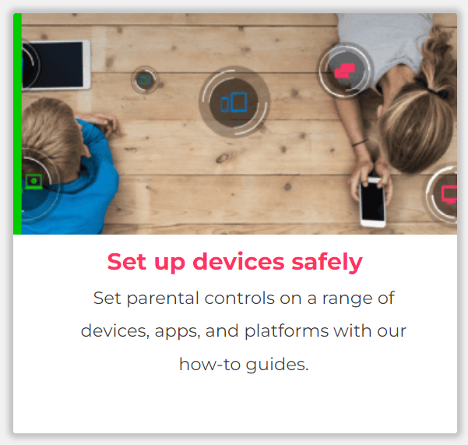
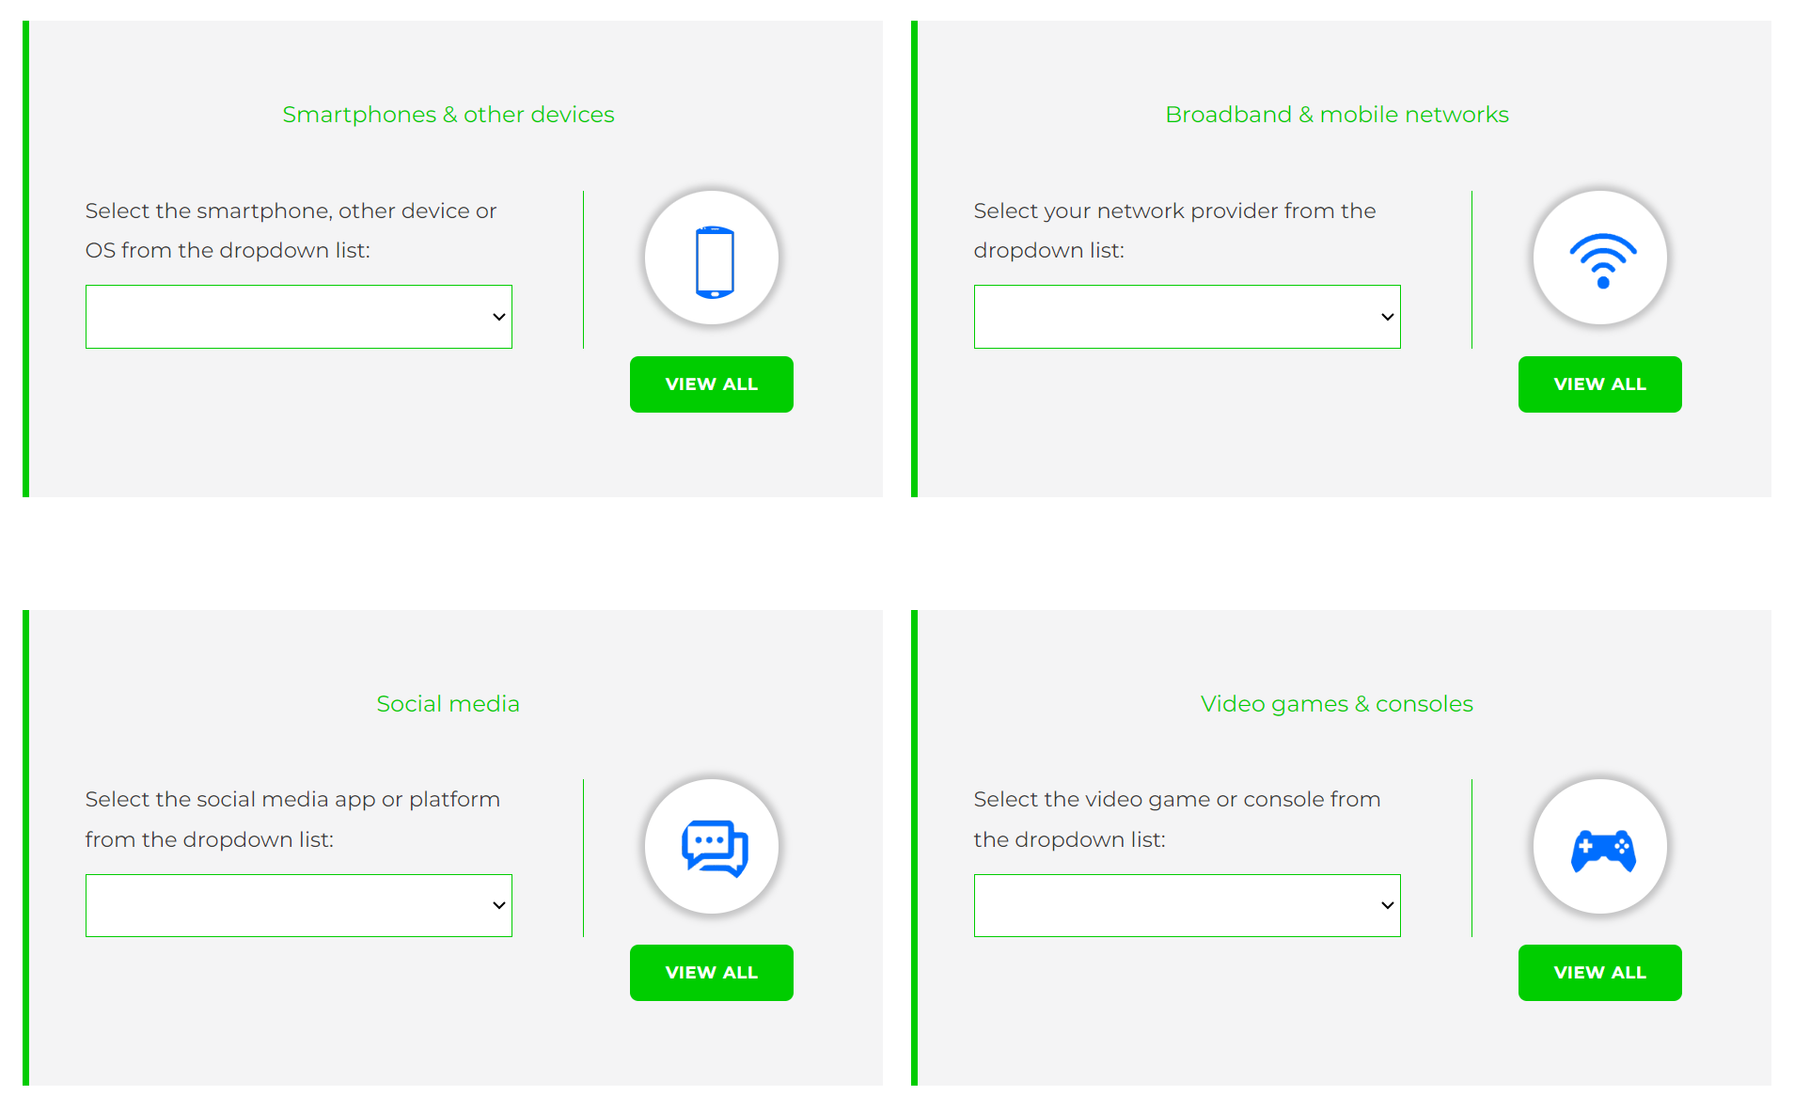
Visit internetmatters.org/parental-controls to find out how to set controls on devices:
Notes:
TELL – They can use this great page to find out how to set up controls on any smartphone, broadband, social media site/app and games console
REMIND - They need to set up parental controls on each of these individually

Slide 29
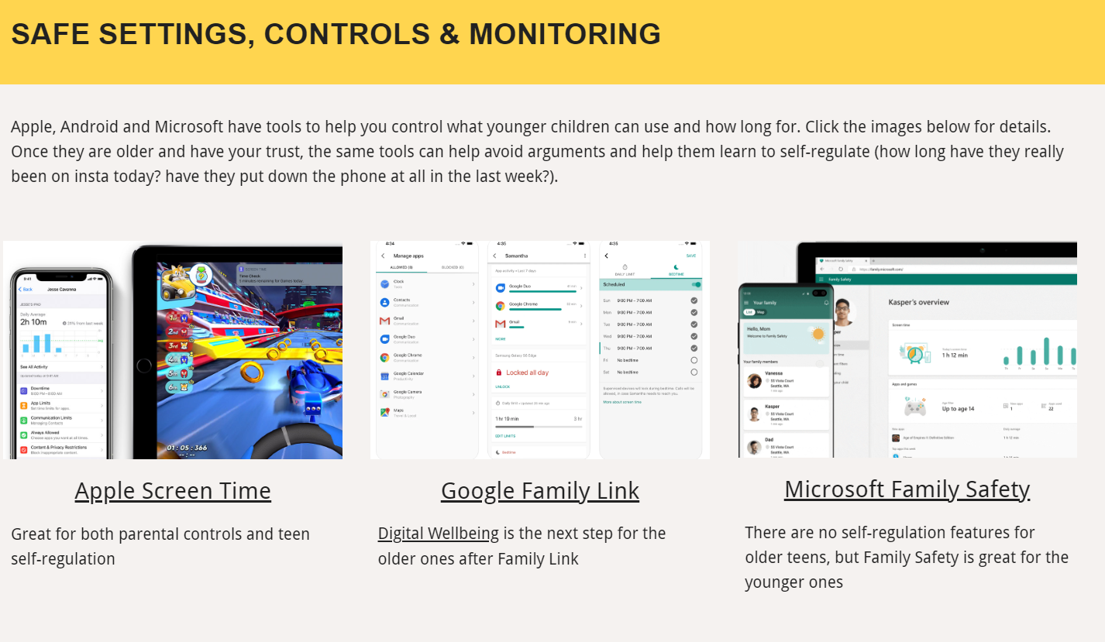
Parental control apps like Google Family Link, Screen Time and Microsoft Family can let you set limits across devices, apps and platforms
Visit parentsafe.lgfl.net/ for additional advice and tips on settings and controls for all devices
Notes:
EXPLAIN - As well as setting controls on your broadband, device, apps, games etc, Parental Control Apps like Google Family Link, Screen Time and Microsoft Family can further enhance safety by letting you set limits across devices, apps and platforms without needing to access these spaces separately. You can manage screen time, app access, inappropriate content restrictions and more.
Screen Time shows you how much time you spend on apps, websites and more. You can also set limits and restrictions for what you want to manage – on your own device or a child's device.
Family link can run on Android devices, e.g. Samsung… Parents can access and manage their child’s account and settings, and delete it if necessary
TIP – Why not run a ‘Bring your device and we’ll show you….’ pupil-led workshop to help parents with this at school?

Slide 30

REMEMBER
As children get older, restrictions and controls you use will change, but only at a pace you feel is appropriate for your child, not pressure from your child “because everyone else is allowed”
Content filters are never 100% effective, at some point your child may come across inappropriate or upsetting content, so make time to talk regularly

Slide 31
SCREENTIME

Slide 32
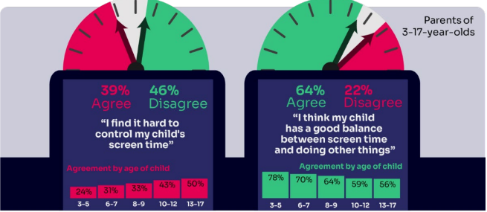
WORRIED about their SCREENTIME? How do you MANAGE this?
Know HOW LONG YOUR CHILD SPENDS online daily?
“I’ve been told is that when I get off my screen, I’m less fun to be around.
..And like I can also feel angrier for like no reason.”
Children spent an average 3 hours 5 minutes per day accessing the internet via smartphones/tablets/computers
Four in ten (39%) parents of children aged 3-17 report finding it hard to control their child’s screentime
Source: Children and parents: media use and attitudes report 2025
Notes:
Four in ten (39%) agreeing that they find it hard to control their child’s screentime, increasing as the child gets to teenage years, with 33% of parents of 3-12s compared to half (50%) of parents of 13-17s agreeing with this statement. A similar sentiment is seen when we ask parents whether they think their child has a good balance between screentime and doing other things. Overall, just under two-thirds (64%) of all parents agree that they do, but the proportion is lower among parents of teenagers; 56% of parents of 13-17s agree that their child has a good balance, compared to 68% of parents of 3-12s.

Slide 33
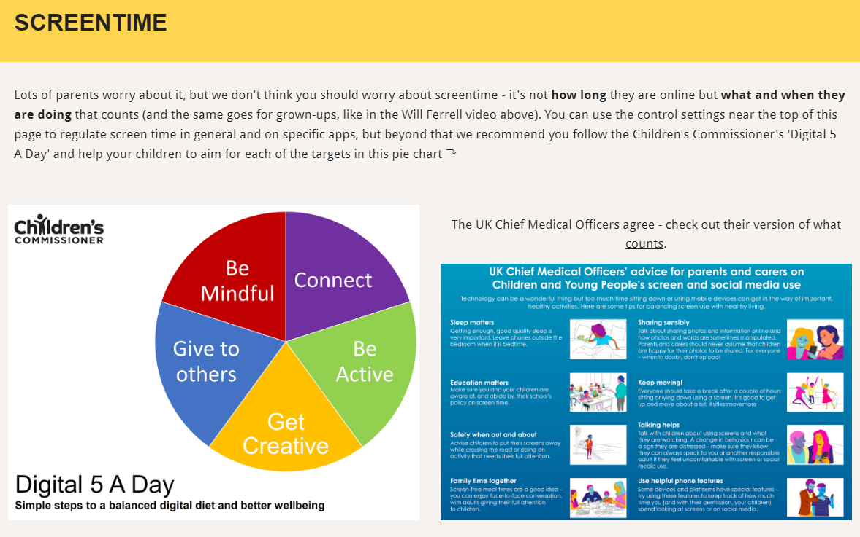
Visit parentsafe.lgfl.net/ for advice and tips to manage screentime
Notes:
ASK – Do you think lots of screentime is a bad thing generally? Why? How long is OK?
SHARE - World Health Organization (WHO) recommendations and research:
Infants (1 – 2 years) are recommended no screentime, whilst for 2 – 4-year-olds sedentary screen time should be no more than 1 hour; less is better.
When sedentary, engaging in reading and storytelling with a caregiver is encouraged
Improving physical activity, reducing sedentary screen time and ensuring quality sleep in young children will improve their physical, mental health and wellbeing, and help prevent childhood obesity and associated diseases later in life.
TELL – It’s not necessarily how long they are online but what and when they are doing that counts - take them through the UK Chief Medical Officer’s advice poster above for examples
EXPLAIN – the Digital 5 A day gives children and parents easy to follow practical steps to achieve a healthy well balanced digital diet, by encouraging them to reach of the targets in the pie chart – share some examples with them https://www.childrenscommissioner.gov.uk/digital/5-a-day/

Slide 34
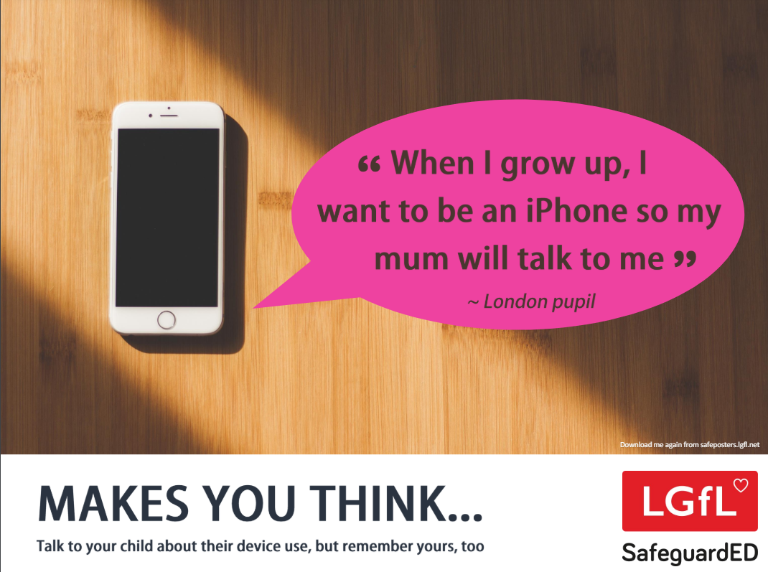
How does your child feel about YOUR SCREENTIME vs THEIRS?
52% of 8-11s feel that their parents’ screentime is too high
33% of 8-17s feel that their own screentime is too high
Source: Children and parents: media use and attitudes report 2025
Notes:
Of the third of online 8-17s who think their screentime is too high, just over half (52%) also think their parents’ screentime is too high, compared with the 15% who do not think their parents screentime is too high, and a quarter (26%) who are not sure.
REMIND – it’s important to model good behaviour when it comes to device use, as children will follow our example. The same goes for ‘sharenting’ (see slide 22)

Slide 35
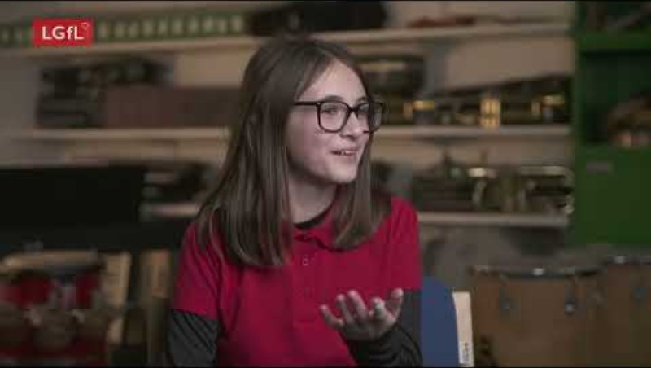
Notes:
PLAY VIDEO – ‘Life Online - What Grownups Just Don't Get!’
This video is part of our playlist on what children and young people actually think about some of the top topics and hot potatoes of the day in 2024. You can discuss key points from this to facilitate conversations to break down barriers to keeping children safe online.
https://youtu.be/Lde52EtjljQ?si=QZSHL0Gn31LRCO1T

Slide 36
SOCIAL MEDIA AND GAMING

Slide 37
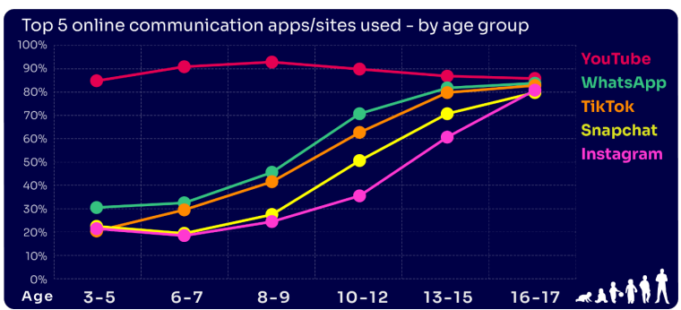
Are you FAMILIAR WITH THE APPS and GAMES your child is on?
YouTube is the most popular, but the appeal of many social media platforms varies by age
The two most popular apps for 3 – 7 yr-olds are WhatsApp (2 in 10) and Snapchat (3 in 10)
The proportion of 8-9s with an Instagram profile increased from 8% in 2023 to 14% in 2024
13-17s are most likely to have profiles on WhatsApp
(62%), Snapchat (62%) or TikTok (61%)
Go to apps.lgfl.net for guidance on apps and social media sites
Source: Children and parents: media use and attitudes report 2025
Notes:
YouTube continues to be universally popular, and the appeal of other social media platforms increases with age . nearly half (48%) of 16-17s use all of the top five apps/ sites that we asked about (YouTube, WhatsApp, TikTok, Snapchat and Instagram).
REMIND – your children need to be 13+ to use these platforms (See slide 39)

Slide 38
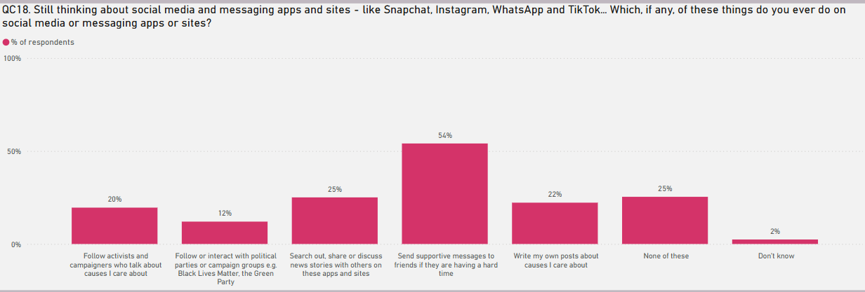
KNOW WHAT THEY DO on social media?
Eight in ten (81%) of all children aged 8-17 use at least one social media app/site for following friends, people and organisations, reading, liking or sharing content
TikTok was the most favoured platform to message and communicate with friends.
Source: Children and parents: media use and attitudes report 2025
Notes:
TELL - Motivations for using these types of app vary, but a key reason is the desire to connect with peers. Seven in ten (68%) 8-17-year-olds who use social media and/ or messaging sites or apps told us that using these types of sites or apps helped them feel closer to their friends, either all or most of the time.

Slide 39
WHY DOES THIS MATTER?
Young people can get around age restrictions on apps and websites, increasing the risk of them coming to harm online
Addictive algorithms can make it harder to take a break and maintain a healthy balance between time on and offline
Algorithms can also target content similar to what you’ve already selected/liked/shared
This can prevent you from finding new ideas and perspectives, create misinformation and reinforce stereotypes
Notes:
ASK – What kinds of risks do you think children could be exposed to? Can you give examples? (See slide 48 for a summary of related risks)

Slide 40
What might they NOT BE TELLING YOU?
Nearly six in ten (56%) 8-17s use multiple profiles on at least one social media platform:
(23%) said it was because one account was just for parents/family to see
15% said one account was for the ‘real me’ and another contained edited/filtered posts or photos
Source: Children and parents: media use and attitudes report 2025
Notes:
TELL - This demonstrates that at least some children feel the need to present distinct aspects of themselves on social media, depending on the audience.

Slide 41
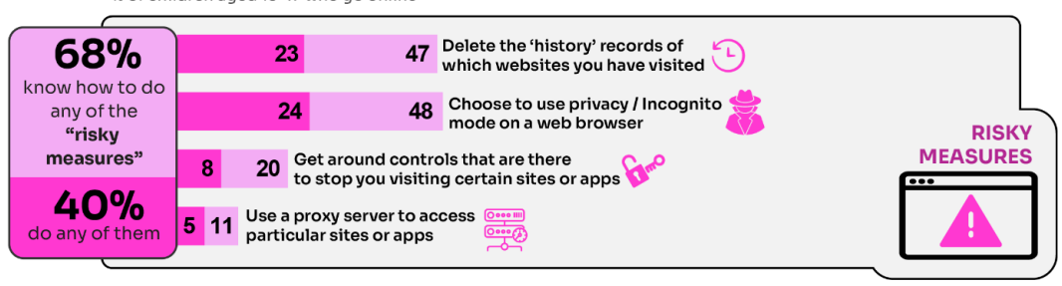
WHY is this ‘RISKY’?
40% had engaged in ‘risky’ behaviour!
Source: Children and parents: media use and attitudes report 2025
Notes:
TELL - This behaviour is considered ‘risky’ because they enable the child to conceal their online activity, preventing a parent or appropriate adult to ensure they are keeping safe online.

Slide 42
What about WHATSAPP?
Do you know the minimum age to use this? What are the risks?
Unwanted contact | to contact somebody on WhatsApp, all you need is their phone number, which could expose you to unwanted messages or calls
Inappropriate content | messages are end-to-end encrypted which means that the content cannot be monitored. This means that your child could see or hear harmful or upsetting content e.g. pornography or violence.
Location sharing | live location feature means that your child could reveal their current location to others
Cyberbullying | children could be bullied, feel left out or deliberately excluded or removed from groups
Oversharing | privacy features, such as disappearing and ‘view once’ messages, might mean that your child feels safe to reveal private or risky information or images. However, there is always a risk that this could be copied and shared
Notes:
TELL - WhatsApp let users send messages and content to contacts added to their account. To use the service in the UK, users must be 13-years-old or older (as of April 2024. The minimum age for WhatsApp used to be 16)

Slide 43

Notes:
PLAY – ‘What's Up on WhatsApp? Group Chats and Kicking’ video showing primary pupils talking about the realities of group chats and exclusion bullying - deliberately being left out to hurt someone's feelings.
https://youtu.be/BpT8vFn6_eA

Slide 44
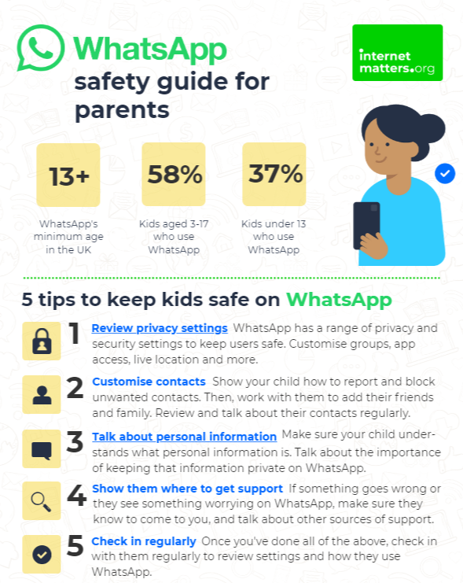
What can you do?
Visit https://www.internetmatters.org/resources/whatsapp-safety-a-how-to-guide-for-parents/#whatsapp-safety-tips for advice for parents
Notes:
SHARE – 5 top tips from the parent safety guide at https://www.internetmatters.org/resources/whatsapp-safety-a-how-to-guide-for-parents/#whatsapp-safety-tips
EXPLAIN – it’s useful to talk with children about etiquette when using group chats e.g.
how to communicate
what language to use/not use
recognition that others may see your messages if copied and shared
what to do if someone is unkind to them or others etc.

Slide 45
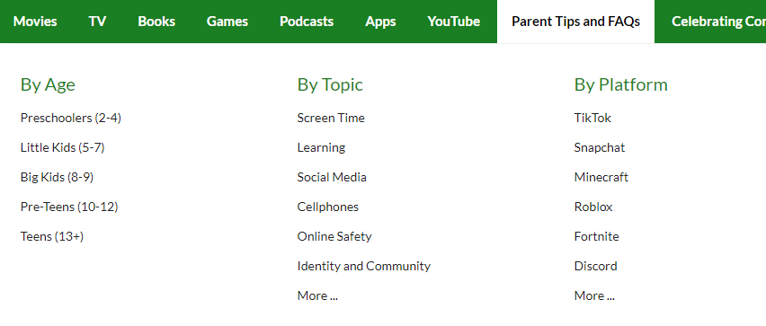
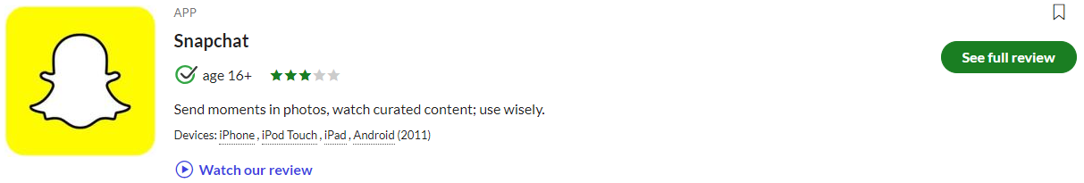

Find ratings and reviews for parents on apps, games and social media at commonsensemedia.org
Notes:
REMIND – they don’t need to be experts, but they can empower themselves by finding out about the suitability of the games/apps their child uses
SHOW – the Common Sense Media page and pick an app or game to show how easy it is to find a review

Slide 46
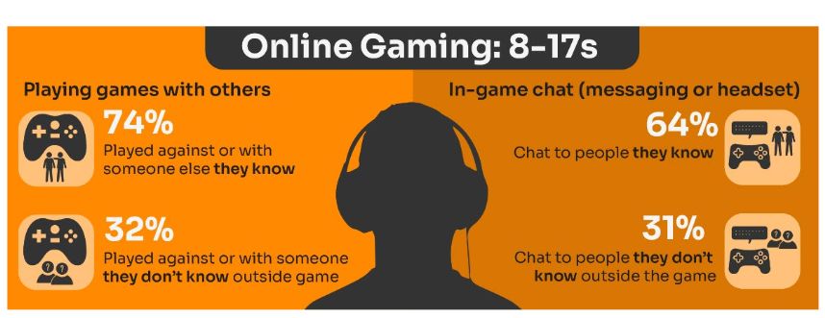
Do you know the DIFFERENCE between an ‘ONLINE’ FRIEND and a real one? How does this differ from your CHILD’S VIEW?
Are you familiar with who they are in contact with whilst playing games?
Have you asked about the chat facility?
Do you know the content and age restrictions for these games?
72%
63%
31%
31%
Visit gaming.lgfl.net for advice and activities
Source: Children and parents: media use and attitudes report 2025
Notes:
TELL:
Children often use online gaming as a tool to communicate with their peers, with 64% of 8-17s who game online chatting through the game with friends and/or people they know in real life.
However, 31% of children who game online, communicate with strangers as well.
A higher proportion of these children now play shooter games. This may raise concerns about how age appropriate the games favoured by some younger children actually are.
While communication via games is a valuable social tool for many children, it can sometimes leave them vulnerable to unwanted interactions. This year (12%) of all children aged 8-17 said someone had been nasty/hurtful to them through an online game

Slide 47
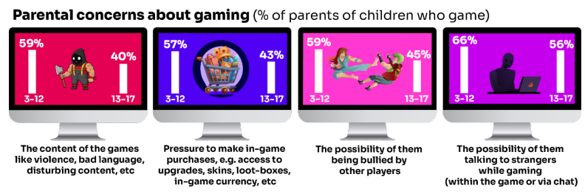
What are YOU most WORRIED about when it comes to GAMING?
Visit gaming.lgfl.net for advice and activities
Source: Children and parents: media use and attitudes report 2025
Notes:
TELL:
The most commonly cited concern among parents of 3-17s whose child games was the possibility of their child talking to strangers while gaming, either within the game or via the chat function (62%).
This was followed by the possibility of their child being bullied by other players (54%), the content of the games the child plays – i.e. violence, bad language, disturbing content etc. (52%), and the pressure on the child to make in-game purchases e.g. for things like access to upgrades, skins, loot-boxes, in-game currency or other rewards (52%).
Overall, parents of younger children are more likely than parents of teenage children (13-17s) to be concerned about these possibilities

Slide 48

Research finds children’s online spaces “saturated” with
GAMBLING-like content and advertising:
“They make it look like a game, it does not look like gambling.”
Risks are not understood by children due to the blurred lines between gambling and gambling-like activity such as loot boxes
Do you DISCUSS THIS when you talk about MONEY to your children and how gambling is made to LOOK ATTRACTIVE and likely that you would WIN?
https://www.gambleaware.org/media/hbcp3qgd/exploring-the-lived-experience-and-views-of-gambling-among-children-and-young-people_final_0.pdf
Notes:
TELL: The report found that gambling was understood to be a normal part of everyday life, and children described it as a part of their experience of growing up. Gambling content was seen with things such as horse racing, scratch cards and the National Lottery, while content that felt like gambling was seen in online games with gambling-like features such as loot boxes. The bright, loud and eye-catching nature of gambling adverts drew children and young people in, and many reported that gambling could look like gaming and vice versa, and the look and feel of the two worlds felt interchangeable.
EXPLAIN: Anyone who plays video games will probably have heard about loot boxes. They can contain useful items, in-game currency, new clothing or even characters that could change the way you play. 9 in 10 young people report that loot boxes are available in the games they play. A common practice if a game includes loot boxes is that the game is free. Typically, the game will make their money from selling tempting items in these boxes through a range of tactics –
ASK: Do you DISCUSS THIS when you talk about MONEY to your children and how gambling is made to LOOK ATTRACTIVE and likely that you would WIN?

Slide 49
How can YOU GET INVOLVED?
ASK what type of games your child enjoys – are they age-appropriate?
PLAY games together - keep the tech in shared spaces rather than bedrooms
TALK about who they are playing with - what information are they sharing?
EXPLAIN what is/isn’t appropriate to share, e.g. personal details to identify them/location
AGREE how they will spend their money online
DISCUSS what they would do if they were bullied online, and what steps to take
DECIDE how long is appropriate to play in one session - how many sessions a day
SETUP these restrictions in parental settings with your child
Visit gaming.lgfl.net for advice and activities to keep them safe

Slide 50
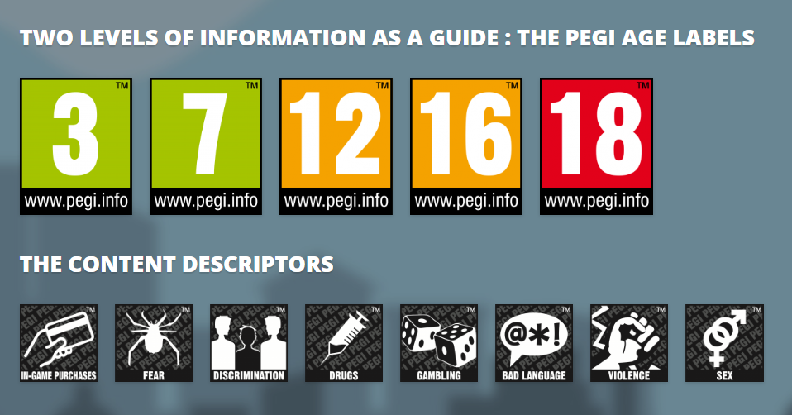
PEGI helps parents to make informed decisions when buying video games:
The age rating confirms that the game content is appropriate for players of certain age
It considers the age suitability of a game, not the level of difficulty
pegi.info
Notes:
UK uses the PEGI (Pan European Game Information) system to give games their age ratings to help people make informed decisions when buying video games or apps through the use of age recommendations and content descriptors. .You can find out more here: https://parentzone.org.uk/article/pegi-games-ratings#:~:text=The%20UK%20uses%20the%20PEGI,about%20how%20PEGI%20classifies%20games.

Slide 51
AGE REQUIREMENTS

Slide 52
Are YOU aware of the MINIMUM AGE REQUIREMENT for social media?
More than a third (37%) say they would allow their child to have a profile on sites or apps before they had reached the minimum age.
83% of parents of 3-17s are aware of a minimum age requirement to have a profile on social media apps
BUT ONLY
33% of parents knew the
correct age requirement
(13 yrs)
Find ratings and reviews for parents on apps, games and social media at www.commonsensemedia.org
Source: Children and parents: media use and attitudes report 2025
Notes:
Over eight in ten (83%) of all parents of children aged 3-17 are aware that there are minimum age requirements for children to set up their own profile on most social media apps and sites, unchanged since 2023. However, only a third (33%) of all parents were able to identify 13 as the correct minimum age on most apps and sites, while three in ten said it was 14 or older. In contrast, 12% of all parents reported the minimum age as 12 or younger, leaving a quarter who either believe there is no minimum age requirement, are unsure if there is one, or don’t know what that age requirement might be. Among parents, those with teenagers are more likely to know the correct minimum age requirement (38% of parents of 13-17s compared to 31% of parents of 3-12s).

Slide 53

What about YOUNG PEOPLE?
Three quarters (75%) of children are aware of minimum age requirements
A third (33%) of 8-17 yr-olds admit to giving a fake age online to access a new app/site
Up to a quarter had changed their date of birth on their profile since initially setting it up
25% of 8-12 yr-olds were more likely to change it on Snapchat
WHY is this WORRYING?
Children’s Online User Ages 2025 Quantitative Research Study

Slide 54

Four in ten under-13s have a profile on social media apps or sites…
YouTube/YouTube Kids (44%)
WhatsApp (23%)
TikTok (23%)
The proportion of 8-9s with an Instagram profile increased from 8% in 2023 to 14% in 2024
Despite there being a minimum age requirement of 13 for using most social media apps, over half of
3-12-year olds (55%) were reported as using at least one social media app or site, an increase on last
year, when 51% of these children did so.
Source: Children and parents: media use and attitudes report 2025

Slide 55
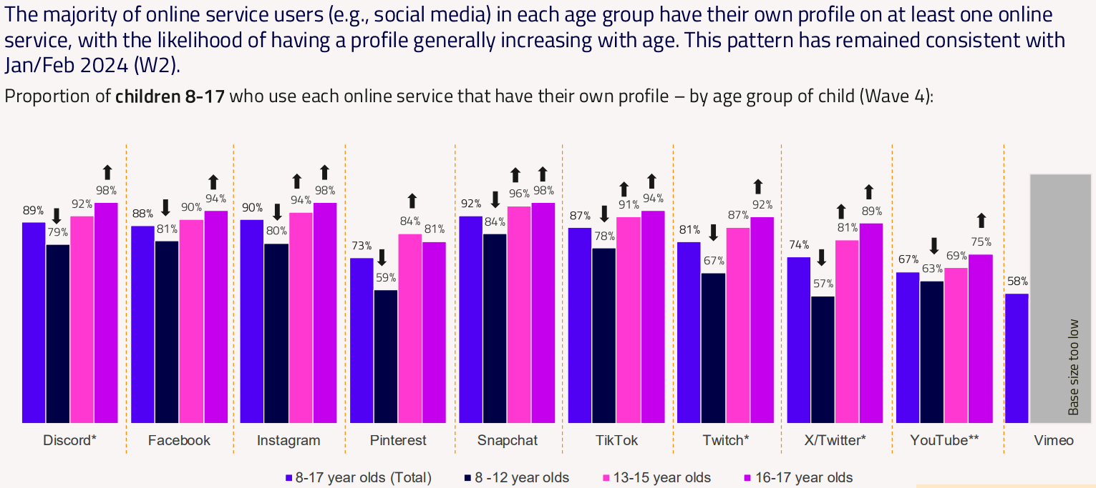
Children’s Online User Ages 2025 Quantitative Research Study
Notes:
*CAUTION - Low base size, figures are indicative only (Ofcom)

Slide 56
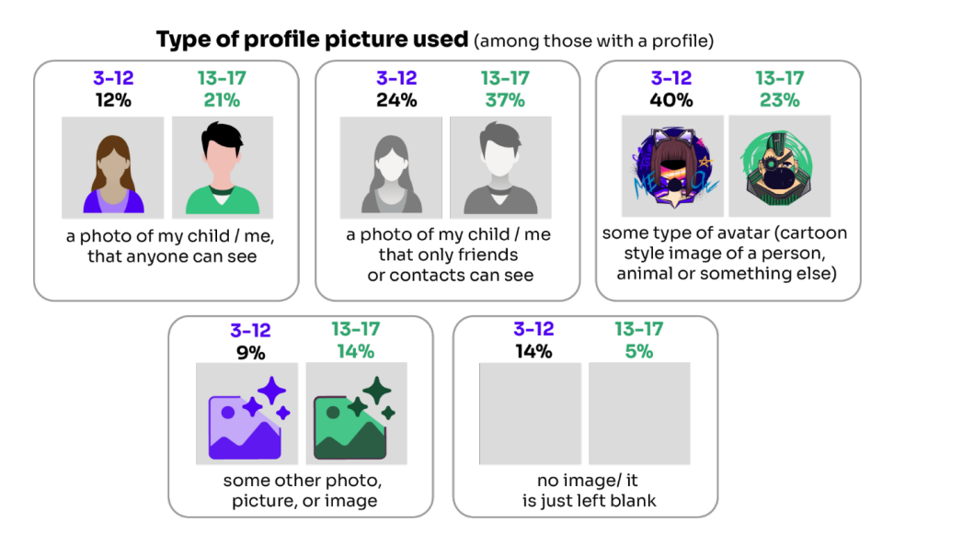
Do you know what they SHARE?
16% of children who have a social media profile include a photo of themselves which anyone can see
Source: Children and parents: media use and attitudes report 2025

Slide 57
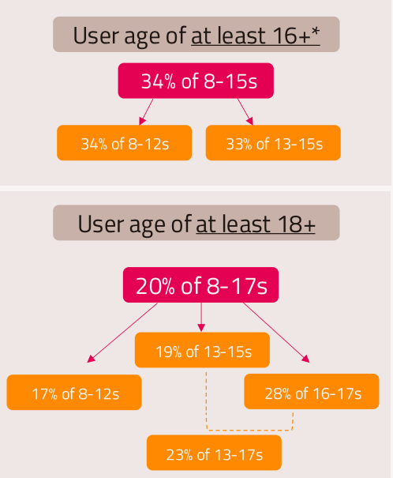
Why does this MATTER?
Young people can get around age restrictions on apps and websites, increasing the risk of them coming to harm online
To understand the extent to which children are bypassing age checks, Ofcom researched how many children have online profiles that make them appear older than they actually are.
Source: Children and parents: media use and attitudes report 2025
Notes:
ASK – Why does this matter?
TELL:
Many children have online profiles that make them appear older than they actually are – exposing them to content inappropriate for their age and harmful online interaction with other users; for example: peer to peer pressure, commercial advertising and adults posing as children or young adults with the intention to groom or exploit them for sexual, criminal, financial or other purposes
Addictive algorithms can make it harder to take a break and maintain a healthy balance between time on and offline
Algorithms can also target content similar to what you’ve already selected. This can prevent you from finding new ideas and perspectives, create misinformation and reinforce stereotypes.

Slide 58
RISKS AND NEGATIVE EXPERIENCES

Slide 59
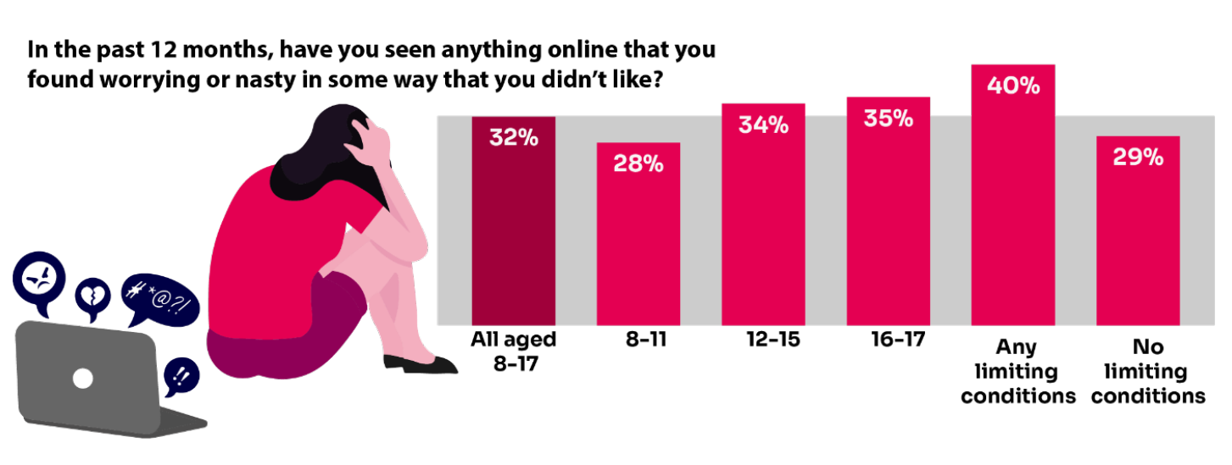
Summary of children’s negative experiences:
BUT Only 20% of parents report their child telling them about this in the same time frame.
Source: Children and parents: Media use and attitudes report
Notes:
TELL:
A third of 8-17-year-old children are being exposed to content online that they find worrying or nasty, but only 20% of parents report their child telling them they had seen something online that scared or upset them in the same time frame.
The likelihood of children seeing this type of content increases with age - just over a third of 12-17s say they have been exposed to this type of content in the past year (34%) compared to 28% of 8-11-year-olds.
NB. Children aged 8-17 who live with at least one impacting condition (e.g. illness, disability, SEND) are more likely than those without such a condition to say they have seen this type of content (40% vs 29%). This indicates that particular groups of children may be more vulnerable than others to being exposed to potentially harmful content.

Slide 60
Current issues that schools are dealing with right now Include:
An internet made for adults accessible to children
Pornography
Threats to harm family members if they don’t…
Gen AI
Bullying
Nudes pressure to share and receiving them
Lack of role models
Grooming Exploitation
Radicalisation
Violent misogyny
Self-harm suicide content
Fake accounts profiles
Disinformation Misinformation what can you believe?
Sexual extortion
Notes:
Talk through the ones most relevant to your school and ask parents if they are familiar with some of these terms, e.g. Gen AI, sexual extortion, misogyny
TELL – we will go over some of these in more detail, but they can find out more at parentsafe.lgfl.net

Slide 61
So what are the RISKS?
content: being exposed to illegal, inappropriate, or harmful content, for example: pornography, racism, misogyny, self-harm, suicide, antisemitism, radicalisation, extremism, misinformation, disinformation (including fake news) and conspiracy theories.
Updated to clarify misinformation, disinformation and conspiracy theories are safeguarding harms
contact: being subjected to harmful online interaction with other users; for example: peer to peer pressure, commercial advertising and adults posing as children or young adults with the intention to groom or exploit them for sexual, criminal, financial or other purposes
conduct: online behaviour that increases the likelihood of, or causes, harm; sharing and receiving explicit images (e.g. nudes and semi-nudes and/or pornography and online bullying
commerce: risks such as online gambling, inappropriate advertising, phishing and or financial scams
Keeping Children Safe in Education
Notes:
TELL - The 4 Cs of online safety is a useful way to identify online safety risks for children (content, contact, conduct and commerce)
We will now take a look at some of these in more detail over the next few slides

Slide 62

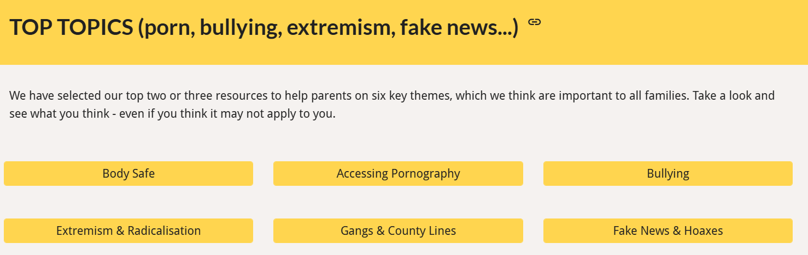
https://parentsafe.lgfl.net/
Notes:
TELL – There is plenty of useful information to support them around these topics at https://parentsafe.lgfl.net/

Slide 63
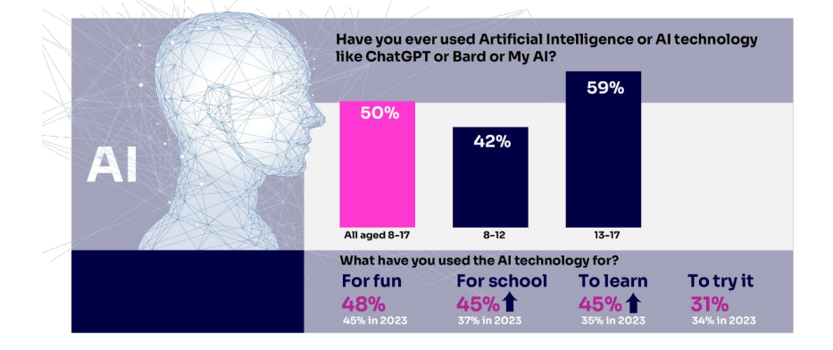

Half of children say they use artificial intelligence (AI) tools
https://www.childnet.com/wp-content/uploads/2025/03/Childnet-Cheat-Sheet-GenAI.pdf
Source: Children and parents: media use and attitudes report 2025
Notes:
ASK – What does Gen AI mean to you?
TELL -Al systems are designed to complete tasks and solve problems that in the past would have needed human thinking. Generative Al (genAl) allows us to ask Al to create things for us, such as photos, music, emails, and recipes and is able to work with and process vast amounts of information to complete the task it is set. GenAl can be found on many different platforms, apps and websites.. Children and young people often use Gen AI for:
Asking questions
Studying and revision
Getting advice
Planning
Coding
Being creative through art or music
For ideas and inspiration
Drafting messages and emails
Analysing data
EXPLAIN: Lots of talk about pupils using it to cheat in coursework but perhaps not as much about some of the very real safeguarding risks
Let’s not forget many gen-ai apps are publicly available to EVERYONE. Many mainstream Social Media and Education Platforms have chatbots or gen-ai functions too!
An Internet Matters report warns vulnerable children are most at risk, with the survey finding 71% of vulnerable children are using AI chatbots. A quarter (26%) of vulnerable children who are using AI chatbots, say they would rather talk to an AI chatbot than a real person, and 23% said they use chatbots because they don’t have anyone else to talk to.
SHOW – Childnet’s Parent Leaflet and scroll through key strategies and pointers to help keep children safe: - https://www.childnet.com/wp-content/uploads/2025/03/Childnet-Cheat-Sheet-GenAI.pdf

Slide 64
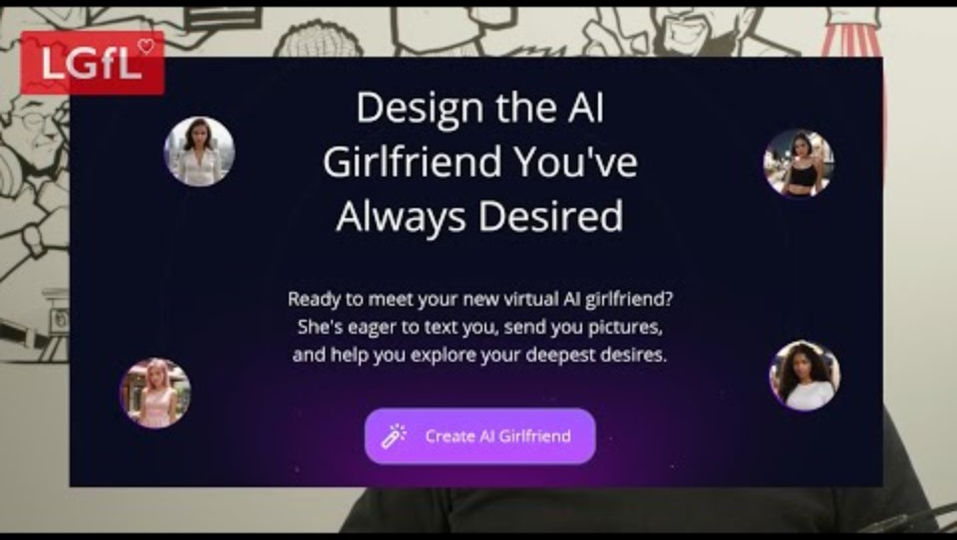
Generative AI – what do you think the risks are ? are?
https://www.youtube.com/watch?v=XEsHwss2x8E&list=PLaIzX4UgxCRl8e_36R79fqLp_qt1imm4D&index=3&t=203s
Notes:
TELL - Children and young people are being exposed to online harm with new generative AI (gen AI) tools which are now everywhere online! These include sexbots, AI girlfriends, nudifying sites, etc. If you think 'my child wouldn't see these things', you may think again when you hear more.
PLAY VIDEO: https://www.youtube.com/watch?v=XEsHwss2x8E&list=PLaIzX4UgxCRl8e_36R79fqLp_qt1imm4D&index=3&t=203s

Slide 65
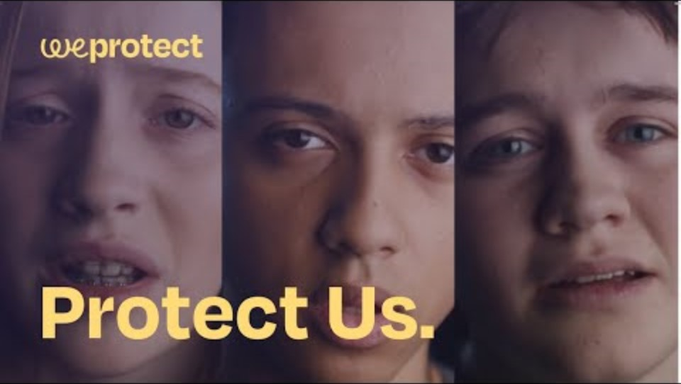
Generative AI – find out how nudify apps might impact young people or why a teenager might make friends with a chatbot
WeProtect
Notes:
TELL: Protect Us is a short film exposing the harrowing ways generative AI applications and chatbots are being weaponised to exploit children online. The video has several dramatised scenarios from real-life stories, so worth watching just one chapter even if you only have two minutes.
PLAY VIDEO https://www.youtube.com/watch?v=OuH-D-au1Ho

Slide 66
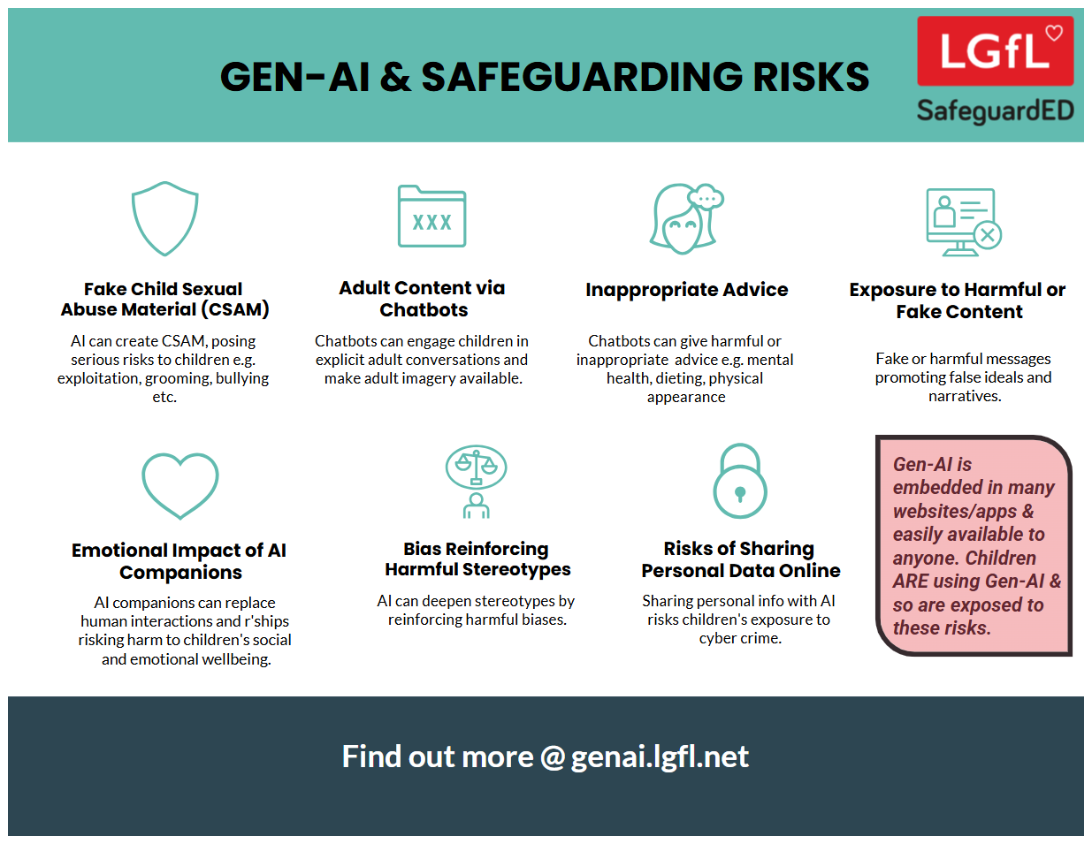
Why not share this poster with parents?
Notes:
Take them through some of the key points from this poster highlighting the safeguarding risks of Gen-AI

Slide 67
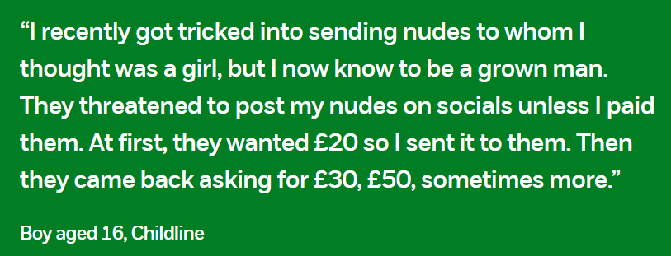
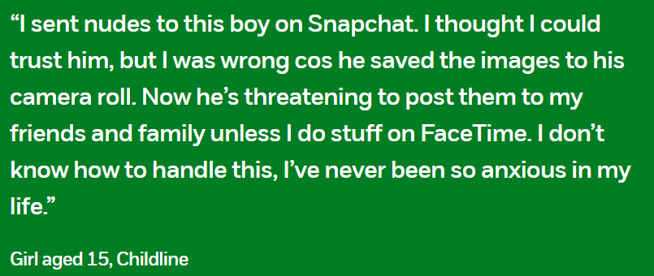
Financially Motivated Sexual Extortion – ‘SEXTORTION’
NSPCC (2024) Young people’s experiences of online sexual extortion or ‘sextortion’. London: NSPCC.
Notes:
EXPLAIN – it is a type of online blackmail involving an adult offender posing as a young person, threatening to release nude or semi-nude images and/or videos of a child or young person, unless they pay money. Victims of any age and gender can be targets - majority of cases have involved male victims aged 14-18
TELL - It’s important to remember that a child or young person is never to blame if they have been blackmailed online. Offenders will have tricked, groomed and/or manipulated them into sharing an image, or created digitally manipulated images of them. The reality is that it could happen to anyone.

Slide 68



https://www.ceopeducation.co.uk/globalassets/professional/nca-fmse-social-campaign-guidance-doc---english.pdf
Notes:
SHARE –
- Financially Motivated Sexual Extortion (FMSE): advice for parents and carers: https://www.ceopeducation.co.uk/globalassets/professional/nca-fmse-social-campaign-guidance-doc---english.pdf - you might wish to scroll through the page and cover key points and advice
- CEOP Parent and carers template letter and talk through key points on talking to your child and how to respond https://www.ceopeducation.co.uk/globalassets/professional/guidance/nca_financially_motivated_sexual_extortion_alert_education_eng.pdf
If you wish to explore this further, please refer to https://www.flipsnack.com/internetmattersorg/dealing-with-sextortion-what-to-do-if-you-re-targeted/full-view.html

Slide 69
Livestreaming
Sixteen per cent of children livestream their own videos
    3-9 year-olds (1 in 10)
    10-12 year-olds (2 – 10)
Why does this MATTER?
Source: Children and parents: media use and attitudes report 2025
Notes:
DISCUSS - Talk through the reasons why people live stream. E.g. Sharing videos instantly and live can feel exciting, showcase talents, campaign against issues, spontaneously share their thoughts with an audience, Show events like music concerts, tutorials e.g. putting on makeup
ASK – What do you think the risks are??
TELL: -
Live streaming presents a number of risks to children and young people which may be divided into whether the child or young person is viewing the live stream or is sharing/hosting the live stream.
Exposure to inappropriate or harmful content via live streaming.
Content can be uncensored and spontaneous.
Content can have a harmless title or description yet contain offensive or harmful content without the viewer realising.
Comments on live streams aren’t moderated and can be viewed by everyone, young people could see upsetting or harmful comments.
The host of the livestream might feel bullied or pressured to do something in the moment by comments from viewers that they might not feel comfortable doing.
Young people might feel more confident or comfortable sharing things online than they would offline.
Live streaming provides ease of access for perpetrators to engage with children and young people.
Viewers can also screen record or take screenshots of the live stream, even without the host’s consent.
2. Live streaming can facilitate sexual abuse in different ways
While any legitimate internet platform could be abused by offenders attempting to contact children, live streaming provides an ease of access through the instant, direct connection ‘viewers’ have to ‘hosts’ while watching live streams. Live streaming may therefore facilitate sexual abuse as offenders utilise live streams to groom and exploit children to undress or perform sexual acts.
Offenders may try to move the child away from the public stream to a one-on-one live streaming chat. Some offenders may capture videos/images of the child to store or distribute or use in further blackmail.
Software can be used to record the live streaming of child sexual abuse and/or still images can be captured of the child sexual abuse during the broadcast

Slide 70



There were more 7-10-year-olds in child sexual abuse material (CSAM) images found by IWF than 11-13s in 2024
It can also affect younger children
Source: IWF Annual Data & Insights Report 2024, published April 2025
Notes:
TELL –
1. The Internet Watch Foundation are the only organisation other than law enforcement who can search for and remove child sexual abuse imagery.91% of all the content they remove of child sexual abuse material, is ‘self-generated’. Self-generated Child Sexual Abuse Material (CSAM) are images and videos which are taken by children and then shared either:
willingly, usually with a boyfriend/girlfriend, or
unwillingly, through coercion, or
shared by a third party without their consent.
Some of these images end up being distributed, sometimes sold, on the open and dark web by those with a sexual interest in children. Sadly, much of this takes place in home environments, where parents believe their children to be safe. But the internet allows people to access you child, unless you have appropriate controls and settings in place.
2. One of the biggest increases seen in the latest data, is the rise in the number of images found of 7-10 year olds. This may surprise some people, as there can be an assumption that this is an issue mainly affecting teenagers.
EXPLAIN - This is one of the reasons why we as schools and parents need to start the conversations as early as possible with children, and to be very considered about when children start using devices and controls around this.
NOTES –
7-10s highest group!!
7-10s and 11-13s remain the main groups
14-15 and 16-17 substantially creeping up over each of past three years, so don’t think ‘they’re growing out of it’

Slide 71
Being safer while live streaming
Talk to them about what they are sharing
Use devices in public spaces e.g. lounge not bedroom
Check privacy and safety settings on the app/site
Be wary of requests to chat in private
Know Support and Reporting functions
Notes:
Other tips to consider if you know your child live streams

Slide 72

So, what can YOU do?
undressed.lgfl.net
Notes:
TELL - LGfL have created this series of resources which are appropriate for very young children, the dangers of taking your clothes off if you are using a device.
PLAY – Undressed video: https://undressed.lgfl.net/

Slide 73
Sharing Nudes / Semi-Nudes
Older girls (aged 16-18) were more likely than boys to have ever been exposed to potentially uncomfortable or unwanted types of contact:
  Asked to share naked/half-dressed pictures of themselves 24%
  Receiving pictures or videos of naked / half-dressed people
  32%
Source: Children and parents: Media use and attitudes report
Notes:
The Online communication among children quantitative research study found that older girls (aged 16-18) were more likely than boys of the same age to have ever been exposed to all ten of the potentially uncomfortable or unwanted types of contact about which they were asked. These include receiving pictures or videos of naked/half-dressed people (32% vs 11%) and being asked to share naked/half-dressed pictures of themselves (24% vs 9%).

Slide 74

Early in the year: Taylor (13) received messages from people she did not know that included nude images or inappropriate messages.
End of year: She had taken steps to reduce this happening by no longer adding people on Snapchat after they had messaged her on Instagram or using Snapchat’s Quick Add feature to talk to strangers.
“I’d probably get one or two messages a month. They want [to add you on Snapchat] because on Snapchat, you can send pictures that you can’t get away with on Instagram.”
“It [receiving an inappropriate message from a stranger] hasn’t happened in a long time. Maybe once in the last year…
It doesn’t happen much anymore because I don’t really talk to people I don’t know any more.”
NSPCC Targeting of Girls Online Report
Children and parents: Media use and attitudes report
Notes:
SHARE – the example above
ASK:
Are there other things you are aware of/have seen?
Do you follow your child on Instagram, or have they added you as a friend?
What else can your child to to protect themselves from people they do not know?
You can refer to https://www.commonsensemedia.org/articles/parents-ultimate-guide-to-snapchat for additional tips

Slide 75




So, what can YOU do?
youtu.be/XjV0lKYpakk?si=6ONdtZJRjfB6bSRj – what parents and carers need to know
youtu.be/E5LA2nKHVZ0?si=gU3_jXFF51TU3vTq – when should you be worried?
CEOP
Notes:
SHARE – play relevant video to encourage discussion:
youtu.be/XjV0lKYpakk?si=6ONdtZJRjfB6bSRj – what parents/carers need to know
youtu.be/E5LA2nKHVZ0?si=gU3_jXFF51TU3vTq – when should you be worried

Slide 76

Pornography
Average age children first view pornography is 13
Substantial proportions viewed it at a much younger age – 27% by age 11 and 10% by the age of 9
Unbearable pressure to view hardcore pornography even if they do not want to
Degrading acts and violence against women
Think it is reflective of real life or healthy relationships
Pornography sites are not the only way, or even the most popular way, that young people access online porn
Wide prevalence of on social media platforms such as Twitter, Snapchat and Instagram
Would you know how to talk to your child about pornography?
Source: https://www.childrenscommissioner.gov.uk/resource/pornography-and-harmful-sexual-behaviour/
Notes:
TELL: Many children’s first exposure is accidental via social media or others showing them
SHARE: these tips on how to talk to your child about pornography - https://www.keepitrealonline.govt.nz/parents/pornography

Slide 77
Snapchat: ‘It’s our evening news…’
Disturbing, graphic and illegal content:
  Fights / beatings / stabbings / raids
  Sexual assaults, sex acts involving children, CSAM
  Sale of weapons and drugs online
  (Some see this type of content several times a day, daily)
Wouldn’t consider reporting – seen what happens to a ‘grass’
While other children use Snapchat’s built-in filters to add funny effects to their selfies, the filter these children experience is the normalisation of humiliation, aggression, violence and crime
Source: Revealing-Reality: Anti-social-Media Report 2023
Notes:
Revealing Reality did this research to explore what some vulnerable children are seeing and doing on their phones
TELL - They’re not viewing this content on the dark web, finding it buried on hard-to-reach websites or through clandestine underground networks. They see it on mainstream social media and messaging platforms, primarily on Snapchat.

Slide 78




UK Reporting Helplines and Services for Children and Young People
NCA
Young people can report concerns about child sexual abuse and exploitation to NCA
Report Remove
A free tool that allows children to report nude or sexual images and videos of themselves that they think might have been shared online
ChildLine
A free, private and confidential service where CYP can talk about anything to a trained counsellor, online or on the phone
Call 101 or 999 if there is an immediate risk of harm to your child
Go to reporting.lgfl.net to find out more
Notes:
TELL – Talk to your children about these free reporting helplines to support them if they are worried.
For older children, The Mix provides help for young people aged 11-25

Slide 79
STAYING SAFE ONLINE AND REPORTING

Slide 80

What do YOUNG PEOPLE do to STAY SAFE ONLINE?
Only 15% had used a reporting or flagging function
(36% were aware of these functions)
Go to reporting.lgfl.net to find out how to remove content from social media and where to report bullying, racial hatred, terrorism, sexual abuse and more
Source: Children and parents: media use and attitudes report 2025
Notes:
TELL - It is positive that children generally know about safety measures, but there seems to be a gap in their knowledge about reporting and putting the knowledge into practice.

Slide 81


Do YOU know HOW TO REPORT to apps / sites?
Internet Matters has helpful guides for social media apps and sites at internetmatters.org/parental-controls/social-media
Notes:
Each social media site has it’s own processes for reporting inappropriate/harmful content.

Slide 82

A simple Google search with the site name, e.g. ‘reporting in Snapchat’ will bring up the steps to take and signpost to the reporting page
Notes:
TELL – you can also do a Google search by typing ‘reporting in______________________________ (name of platform)’

Slide 83
Remember!
Before signing up to any app/site, check that your child meets the minimum age requirement for the platform to understand the risks
Remind your child to be cautious about accepting friend requests - a real friend is someone they/you know in real life, not a ‘friend’ they met gaming or in a chat room. Encourage them to ask you for advice if they are unsure.
Stress the importance of not sharing personal information with online ‘friends’
Keep passwords confidential
Check their privacy settings - emphasising the importance of not sharing personal information with strangers, and keeping passwords confidential are all important steps
Report any content - e.g. a post, image or harmful, misleading or damaging comment
Reporting doesn't guarantee immediate removal - platforms assess reported content based on their rules and policies

Slide 84
Remember!
Before signing up to any app/site
check that your child meets the minimum age requirement
Remind your child to be cautious about accepting friend requests:
a real friend is someone they/you know in real life, not a ‘friend’ they met gaming or in a chat room.
Stress the importance of not sharing personal information with online ‘friends’
Keep passwords confidential
Check their privacy settings
emphasise the importance of not sharing personal information with strangers
Report any content
e.g. a post, image or harmful, misleading or damaging comment
Reporting doesn't guarantee immediate removal
platforms assess reported content based on their rules and policies

Slide 85
UK Reporting Helplines and Services for Children and Young People
NCA
Young people can report concerns about child sexual abuse and exploitation to NCA
Report Remove
A free tool that allows children to report nude or sexual images and videos of themselves that they think might have been shared online
ChildLine
A free, private and confidential service where CYP can talk about anything to a trained counsellor, online or on the phone
Call 101 or 999 if there is an immediate risk of harm to your child
Go to reporting.lgfl.net to find out more
Notes:
TELL – Talk to your children about these free reporting helplines to support them if they are worried.
For older children, The Mix provides help for young people aged 11-25

Slide 86
CRITICAL THINKING

Slide 87

Does your child TRUST everything they see online?
For young teenagers (12-15s), although TikTok continues to be their most-used single source for news, their most trustworthy source for news is their family.
Sixteen and seventeen-year-olds are less sure of their ability to distinguish the real from the fake online than they were last year
Source: Children and parents: media use and attitudes report 2025
Notes:
There continues to be a slight disparity between their confidence in judging whether something online is fake or real and their actual ability to do so.
girls aged 13-15 are more likely to be both less confident and less able than their male counterparts to judge if what they see online is real or fake (12% vs 6%).
TELL – AI (artificial intelligence) has made it easier for anyone to create fake content, which can make it difficult to distinguish truth from fiction. A notable example of AI-generated misinformation occurred in the United States during the recent presidential election. AI was used to create deepfake videos and false narratives that were disseminated across social media platforms, causing confusion and distrust.
ASK – as adults do we demonstrate good critical thinking skills about things we see online?

Slide 88

DISINFORMATION / MISINFORMATION / FAKE NEWS – what do these terms mean to you?
Try our Critical Thinking Quiz at believe.lgfl.net
Notes:
TELL – We often interpret information through the filter of our values, feelings, beliefs and past experiences. Things are not always as they appear to be, but with some careful consideration, we can learn to think critically to make the right choices about who and what is trustworthy online.
ASK – as adults do we demonstrate good critical thinking skills about things we see online?

Slide 89
Match the terms to the definitions
Disinformation
Misinformation
Fake news
Agenda
Propaganda
what you want to achieve by sharing certain messages or content
presenting inaccurate stories or hoaxes as factual reporting or journalism
accidentally sharing inaccurate information – not trying to trick anyone
deliberate and selective use of facts and/or misleading information to influence choices, actions or beliefs
deliberately sharing inaccurate information – to trick, confuse or influence

Slide 90
Disinformation
Misinformation
Fake news
Agenda
Propaganda
deliberately sharing inaccurate information – to trick, confuse or influence
accidentally sharing inaccurate information – not trying to trick anyone
presenting inaccurate stories or hoaxes as factual reporting or journalism
what you want to achieve by sharing certain messages or content
deliberate and selective use of facts and/or misleading information to influence choices, actions or beliefs
Notes:
Ask students to come up with an example of each of these terms, either online or offline

Slide 91
Match the terms to the definitions
Stereotype
Opinion
Fact
Context
information that is true and backed up by evidence
background or surrounding information to help you fully understand something that could have a different meaning on its own
a fixed or oversimplified idea about what someone or something is like
a belief based on personal feelings, which cannot be proved

Slide 92
Stereotype
Opinion
Fact
Context
a fixed or oversimplified idea about what someone or something is like
a belief based on personal feelings, which cannot be proved
information that is true and backed up by evidence
background or surrounding information to help you fully understand something that could have a different meaning on its own
Notes:
Explain:
At times, people, whether consciously or not, will frame opinion as fact and vice versa. Others may agree or disagree with an opinion, but they cannot prove or disprove it. This is what defines it as opinion.
It can be difficult to extract truths from a person’s preferences and biases - luckily the language used often throws up helpful clues in the forms of words and phrases to identify statements as fact-based or opinion-based.
Facts and opinions must be placed in context to draw conclusions from them.

Slide 93

Echo chambers create misinformation, reinforce stereotypes and distort one’s perspective, making it harder to consider opposing viewpoints
Social media can act as an ‘echo chamber’ - a place where individuals find their ideas supported and echoed by other like-minded individuals
A filter bubble is
a type of echo chamber created by algorithms that keep track of what you click on
Websites use algorithms to show content similar to what you’ve already selected. This can prevent you from finding new ideas and perspectives online
Sharing things that appeals to others in echo chambers makes it more popular and spread faster – even if it isn’t true!
And makes it easier to confirm existing beliefs

Slide 94
Notes:
https://www.thewrap.com/the-internets-favorite-trump-putin-pic-is-fake-news/

Slide 96



What can you do about filter bubbles?
Look at things in context
Look for evidence to separate facts from opinion
Question what you come across and consider other points of view
Follow accounts you might not always agree with, so algorithms can show you a variety of viewpoints
Only share something if you’re certain
Just because you WANT it to be true, doesn’t mean it is!

Slide 97
32% of 8-17s had seen something they found worrying or nasty online in the past 12 months
59% of parents were concerned about them being influenced by extremist content
Visit goingtoofar.lgfl.net to find out how to help children:
  recognise extremist behaviour and content on social media/apps/games
  understand actions likely to attract police investigation
  get help
  report concerns
Source: Children and parents: media use and attitudes report
Notes:
Last year, just under one in ten 12-15s said they often saw ‘hateful content’ online For the purposes of our survey, ‘hateful content’ was described as anything that had been directed at a particular group of people based on, for instance, their gender, religion, disability, sexuality, or gender identity. Overall, half of 12-15s said they had encountered this type of content online in the past year, with 8% saying that they had seen it often.

Slide 98

Are YOU aware of the IMPLICATIONS your ACTIONS could have?
Could be you the law?
Or putting yourselves or others at risk?
Let’s take this quiz together at takingastand.lgfl.net
Visit goingtoofar.lgfl.net to find out more.
Notes:
Children had adopted different strategies for dealing with hateful content. Six in ten 12-15 year-olds said they had taken some action on seeing it. But some, depending on their actions, might have inadvertently shared the content further. Around a fifth said they had responded to the post/video/comment by ‘disliking’ it or commented on it to say they thought it was wrong, or shared it with their friends, saying it was wrong. Doing this brings the risk that their action will appear in their own social media feed, which is then seen by others, inadvertently further sharing the content. Meanwhile, 25% chose to block the person who shared or made the comments, while 22% reported it to the website. Although girls aged 12-15 were more likely than boys to inadvertently share the content by disliking the post/comment/video (27% vs. 13%), they were also more likely than boys to take constructive action in reporting the content to the website (33% vs. 10%).

Slide 99

1. You notice lately there are lots of posts from a group appearing on your page which are offensive and racist.
What can you do about it?
Notes:
TELL - The following are some examples of scenarios the Going Too Far ‘What would You Do If?’ scenario-based quiz that can be used to talk to children about what they would do in similar situations. You can find the complete quiz with all the scenarios at takingastand.lgfl.net

Slide 100
Nothing, just ignore them
Report them directly via the site’s report button
Select the option to unfollow or stop seeing posts from this group
Notes:
Ask: what could be the consequences ignoring these posts?
Remind: free speech does not extend to content that is abusive, hateful or designed to incite violence, and that whilst some hate speech may not be deliberately intended to cause harm it could incite violence, especially as things can escalate rapidly online.
Check: Do they know how to report directly on platforms/sites and to unfollow?
** the correct answers change to green when you click ‘next’ in slide show mode

Slide 101

2. Your class are all talking about this funny meme. It’s making fun of people from another country, and some of the comments are really rude.
There are lots of ‘likes’.
How could you respond?

Slide 102
• ‘Like’ it – after all it can’t do any harm
• Join in the comments so you can also be part of the group
• Share it
• Report it directly to the site as racism
• Talk to a trusted adult for advice
Notes:
Ask: what could be the consequences of joining in with comments, or sharing the meme wider?
Explain: Even by ‘liking’, they are associating themselves with this narrative and it could having a damaging impact on their digital footprint.
Tell: whilst they may not be breaking the law, it is a common tactic by extremist groups to post content using humour and relating it to current events. It may not appear implicitly violent or harmless, but is designed to plant a seed and incite strong feelings in people or normalise hateful behaviour. This can make it easier to dehumanise people. So whilst it may seem funny, sharing such content can give legitimacy to extremist views as hateful ideas becomes ingrained and more widely accepted.
Remind: speak to a trusted adult if they are worried – they can also report directly to the site, or anonymously via reporting channels – signpost them to the ‘Getting Help’ section on the website.
** the correct answers change to green when you click ‘next’ in slide show mode

Slide 103
3. This pop star tweets a post showing how she’s lost weight by taking these diet pills- she says the first 100 people can get it half price.
What could you do?

Slide 104
Buy them straight away
Think about her motives - she might be being paid to advertise it
Check the reviews
Discuss with a parent/carer before buying anything online
Do your research and to find out more about this subject
Notes:
Ask: can you think of any similar examples of manipulation?
Discuss: what could be the risks of going ahead and buying these diet pills?
Tell: it is easy to come across content that is dangerous or damaging to your health as things are not always regulated online, especially on social media.– often the risks of a quick-fix can outweigh the benefits.
Remind: always check a variety of trusted sources to validate the facts before making any decision, and check with a trusted adult, especially if it involves paying for something.
** the correct answers change to green when you click ‘next’ in slide show mode

Slide 105
9. An influencer you came across shared a link where you can meet new friends and chat anonymously without worrying about getting in trouble with the law.
What could you do?

Slide 106
Join the chat, after all it’s anonymous so it can’t do any harm
Invite one of your friends to come along so you can both make new friends
Check with a trusted adult at home or school
Notes:
Ask: are you more likely to believe something if it is said by an influencer or celebrity? Why?
Discuss: can posts always remain anonymous online?
Explain: influencer-led events can be appealing but also provide an exaggerated belief in the legitimacy of their claims. Often such chat rooms or forums can take place in an arena surrounded by like-minded people where these views are not challenged – this is called an echo chamber. A person could then be encouraged to explore content on imageboards where users can engage anonymously and more freely in extremist discussions or hear the ‘truth’ without censorship. It’s easy to join in with negative viewpoints online, which in turn can introduce you to harder opinions that are designed to be hateful towards others.
Remind: social media can act as an ‘echo chamber’ and create misinformation, reinforce stereotypes and distort one’s perspective, making it harder to consider opposing viewpoints.
** the correct answers change to green when you click ‘next’ in slide show mode

Slide 107
RESOURCES AND SUPPORT

Slide 108

Visit parentsafe.lgfl.net for tips and ideas to help parents:
Manage screen time
Set controls and settings
Understand apps and games
Talk to children about risk - from bullying & sharing content, to extremism & gangs
Notes:
TELL:
Remember, the online world can be both exciting and treacherous. Just as you’d look both ways before crossing the street, take a moment to assess the digital landscape.
Stay informed, stay connected, but most importantly, keep talking to your child.
ParentSafe is a dedicated website for parents, to help them to stay up to date with online safety and empower them to have meaningful discussions with their child to keep them safe.

Slide 109
Find conversation starters, story time ideas and top tips to reinforce key safety messages at parentsafe.lgfl.net
Source: Children and parents: media use and attitudes report 2024
Notes:
You may wish to scroll through parentsafe.lgfl.net and showcase some of the resources or videos here too. We’ve selected a few in the following slides for you, but feel free to choose any relevant resources to suit your audience.

Slide 110

Notes:
TELL - why not put this fridge-friendly poster on your fridge?

Slide 111

parentsafe.lgfl.net
Notes:
TELL - If you have an online tutor for your child, we have some useful tips and areas for consideration in this poster.

Slide 112
Why not have a family agreement to:
clarify what is allowed...or not
establish ground rules like no phones at the table or in the bedroom at night-time
agree shared expectations to reduce arguments and keep everyone safe & healthy
Download it at parentsafe.lgfl.net/digital-family-agreement
Notes:
TELL - LGfL have a free template of a digital family agreement that parents could sit down and populate with all family members to agree what is and is not allowed within their family around tech use. This includes parents! We need to role model good behaviour.
ASK – Can you think of any examples of how we as parents can model good behaviour?

Slide 113

parentsafe.lgfl.net
Notes:
TELL - This is an example of a completed agreement to help you get started
Go through some of the example statements and discuss ideas for parents to be good role models, e.g. no devices at the dinner table, asking permission before sharing their child’s images (this is SHARENTING - see slide 23 for more information about sharenting)

Slide 114
Where to get help?
INSERT SCHOOL SPECIFIC INFO HERE, SUCH AS:
DSL NAMES AND PHOTOS
REPORTING PROCESS
LINK TO POLICIES
Notes:
Please amend this slide with anything further you want to tell parents about reporting concerns to the school and seeking help

